Slide 1
BMR 617
Exploring data and relationships between variables:
Review and Summary

Slide 2
Types of data
Categorical data
  Nominal
  Ordinal
Quantitative data
  Interval
  Ratio

Slide 3
Roles of variable
Response variable
  The particular focus of a question in the study or experiment
Explanatory variables
  Variables that predict or explain changes in the response variable
Role of variable defined by experimental design
The type and role of variables determine much of the analysis

Slide 4
C → C
Example: vaccine trial
  Explanatory variable is the treatment (factor with levels "placebo" and "vaccine")
  Response variable is whether or not the subject became infected (factor with levels "infected" and "not infected"
When the explanatory and response variables are both categorical, typically present data using a contingency table
We typically compute the risk for each group and the relative risk
  Other measures include the attributable risk and number needed to treat

Slide 5
C → Q
Examples include our mouse data
  Response variables are quantitative: cholesterol level, fat mass, body weight, triglycerides level, glucose level
  Explanatory variables are categorical: mouse strain (C57BL/6 or TALLYHO), and diet (Chow, High-fat, Low-fat high calorie)
Present data using box plots, column scatter plots, or bar charts
Compute mean or median, along with measures of spread, such as standard deviation, standard error of the mean, or interquartile range

Slide 6
Q → Q
Examples include the insulin resistance data
Present data using a scatter plot
Compute correlation coefficient
  Later we'll also talk about linear regression

Slide 7
Confidence intervals
Framework:
  Our data is a sample from a population
  We compute statistics (such as a proportion, relative risk, mean, etc.) from the sample
  These are estimates of the same statistic in the population
Given a chosen level of confidence (e.g. 95%), we calculate a range of values which we are 95% confident will include the "true" value of the population statistic
Computed confidence intervals for proportions and for means of quantitative variables

Slide 8
Distributions
A distribution describes the probability a variable will take on a value, or a range of values
The "Normal" or "Gaussian" distribution is a particular distribution with "nice" mathematical properties
  Symmetric about the mean
  Unimodal
  Determined entirely by the mean and standard deviation
  Software (or statistical tables) can be used to find the probability a normally-distributed value takes on any given range of values

Slide 9
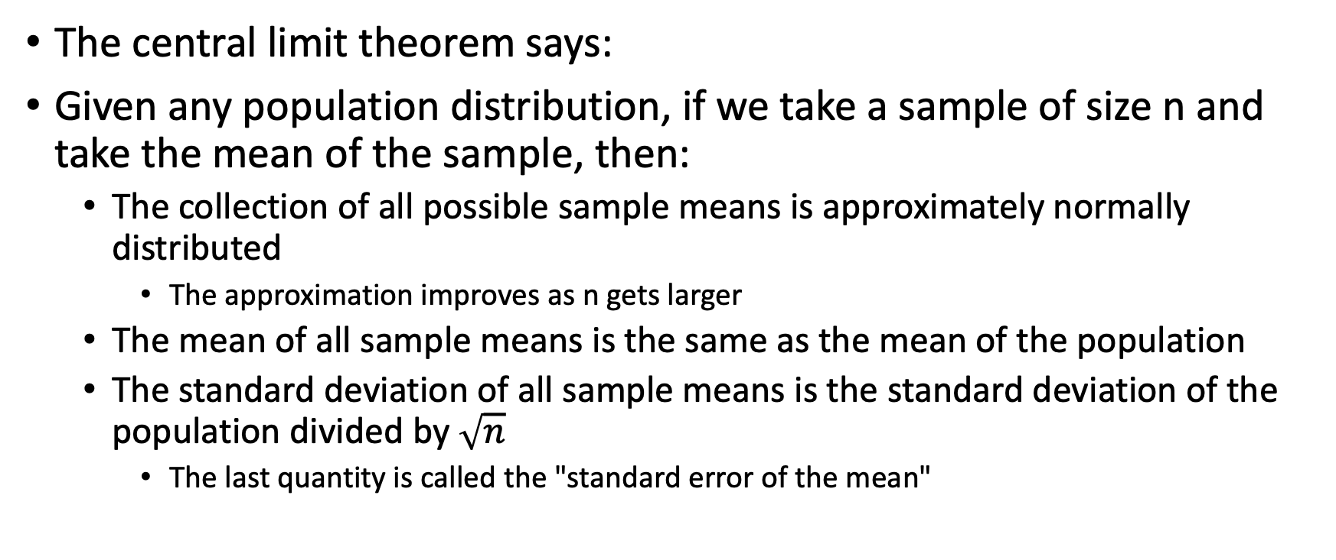
The central limit theorem
The central limit theorem says:
Given any population distribution, if we take a sample of size n and take the mean of the sample, then:
  The collection of all possible sample means is approximately normally distributed
    The approximation improves as n gets larger
  The mean of all sample means is the same as the mean of the population
  The standard deviation of all sample means is the standard deviation of the population divided by $\sqrt{n}$
    The last quantity is called the "standard error of the mean"

Slide 10
R
Using libraries:
  Install a package (once only per installation of R):
  install.packages("tidyverse")
  Load a library (once each session):
  library(tidyverse)

Slide 11
Types of variable in R
Can see the type using class(x) or looking in the "Environment" tab
Categorical
  character or factor
Quantitative
  numeric
Special NA value represents missing data

Slide 12
Loading data
Use the tidyverse function
read_csv(…)
There are similar functions for loading other data formats (tab-delimited, etc.)
Results in a "tibble" (data table)

Slide 13
Confidence intervals of proportions
Use the binom library
Choose from a variety of methods
  Typically either "asymptotic" or "exact"
  Avoid "asymptotic" if the proportion is close to 0 or 1

Slide 14
Confidence interval of a mean
Computed this from a formula, using the qt(…) function
If C is the desired confidence level, s is the sample standard deviation, and n is the sample size, the margin of error is
qt((1+C)/2, df=n-1)*s/sqrt(n)
and then the confidence interval is the mean plus or minus the margin of error

Slide 15
Plots
Use the ggplot2 library, which is part of tidyverse
Start a plot with
ggplot(dataTable, aes(x=…, y=…))
Then add layers using various geom_ functions
  geom_boxplot
  geom_point
  geom_bar
Configure axis with xlab, ylab
Create title with ggtitle

Slide 16
Colors
Change color of bar chart with scale_fill_xxx functions
scale_fill_manual will let you specify colors manually:
ggplot(met_summary, aes(x=Diet, y=MeanCholesterol, fill=Strain)) +
geom_bar(stat="identity", position=position_dodge()) +
geom_errorbar(aes(ymin=MeanCholesterol-sem, ymax=MeanCholesterol+sem),
position=position_dodge(0.9), width=0.2) + scale_fill_manual(values=c("red","blue"))

