Slide 1
BMR 617
Hypothesis tests for proportions

Slide 2
Test for a single proportion
Example:
In a study of Neonatal Abstinence Syndrome, DNA samples were taken from 34 pregnant women in West Virginia with substance use disorder and sequenced.
  For the variant rs6972158 in the gene NPSR1, 27 of the 68 alleles were found to be the variant allele G (41 were the reference allele A).
  According to the 1000 Genomes Project, the G allele frequency in the American population is 0.235.
We want to know if the variant allele frequency in this population is different to that of the general American population

Slide 3
Formulating the question as null and alternative hypotheses
The null hypothesis is the hypothesis we would tend to assume with no other data
The alternative hypothesis is typically the hypothesis we would like to "prove" (or provide evidence to support)
The null hypothesis here is:
  The G allele frequency in the study population is 0.235
The alternative hypothesis is:
  The G allele frequency in the study population is not 0.235

Slide 4
R code for testing a value of a single proportion
In R, we can test the null hypothesis that a proportion is equal to some given value using the prop.test() function
To see how to use the function, type ?prop.test in the console, or search for prop.test in the help tab.
In our case, we have 27 G alleles out of a total of 68 alleles, and the probability of a G allele under the null hypothesis is 0.235:
prop.test(27,68,0.235)

Slide 5
Output
1-sample proportions test with continuity correction
data: 27 out of 68, null probability 0.235
X-squared = 9.053, df = 1, p-value = 0.002623
alternative hypothesis: true p is not equal to 0.235
95 percent confidence interval:
0.2826780 0.5231249
sample estimates:
p
0.3970588

Slide 6
Interpreting the output
The sample estimate (i.e. the estimate of the probability of a G allele from the sample) is 0.397
  You can check that this is just the number of G alleles in the sample divided by the total number of alleles: 27/68
The 95% confidence interval for the proportion is [0.283, 0.523]
  We are 95% confident that the interval[0.283, 0.523] contains the true value of the proportion of G alleles for West Virginian pregnant women with substance use disorder
The p-value is 0.002623. This means that if the null hypothesis were true, there would be a 0.2623% chance of seeing data "this extreme"
  i.e. if the proportion of G alleles among West Virginia pregnant women with SUD were 0.235, there would be a 0.2623% chance of seeing data this different to that in a study of 34 such women

Slide 7
Interpreting the result
Since the p-value of 0.002623 is less than our predetermined threshold of 0.05, we would reject the null hypothesis and conclude that the proportion of G alleles in this population is different to 0.235
  Since the entire 95% confidence interval is above 0.235, we'd conclude it's more than 0.235
Possible explanations:
  The allele frequency in West Virginians is greater than that of the general US population
  The allele frequency among women likely to become pregnant is greater than that of the general US population
  The allele frequency among those with SUD is greater than that of the general US population
  Some combination of the above

Slide 8
Comparing proportions
Remember the Pfizer COVID-19 vaccine trial:
What we want to know here is if the proportion infected (the risk) in the vaccine group is different to the proportion infected (the risk) in the placebo group
  We want to compare two proportions
 |  | Treatment
 |  | Placebo | Vaccine | Total
SARS-CoV-2 status | Infected | 162 | 8 | 170
 | Not infected | 18163 | 18190 | 36353
 | Total | 18325 | 18198 | 36523

Slide 9
Comparing proportions formulated as a hypothesis test
The null hypothesis is that the risk in the vaccine group is the same as the risk in the placebo group
The alternative hypothesis is that the risk is different in each group
To calculate a p-value, we assume the risk is the same in both groups, and calculate the probability that we would get data as different as we got in the actual trial
There are two distinct approaches
  Fisher's exact test
  The Chi-squared test

Slide 10
Fisher's exact test
The trial has 18325 and 18198 participants in the placebo and vaccine groups, respectively
170 participants were infected and 36353 were not infected
Fisher's exact test, at least conceptually, examines all possible contingency tables with these row and column totals, and calculates the probability of each one
It then sums the probabilities of the tables in which the proportions between the groups are at least as big as the one observed

Slide 11
Chi-squared test
The Chi-squared test works by calculating the "expected" value of each cell in the table if the proportions were equal in each group
Overall, 170 out of 36523, or 0.004655 of the participants became infected
There were 18325 participants in the placebo group, so assuming the null hypothesis, we'd expect, on average, 0.004655 x 18325 = 85.3 participants in the placebo group to become infected, and 18239.7 not to become infected
Similarly, there were 18198 participants in the vaccine group, so we'd expect 0.004655 x 18198 = 84.7 to become infected, and 18113.3 not to become infected

Slide 12
Chi-squared test: observed and expected tables
Observed data
162 | 8
18163 | 18190
Expected data
85.3 | 84.7
18239.7 | 18113.3

Slide 13
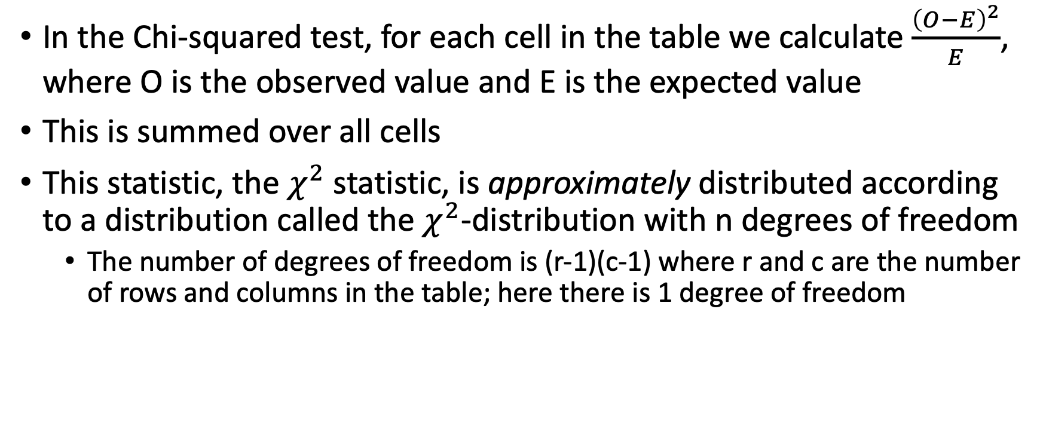
How the Chi-squared test works
In the Chi-squared test, for each cell in the table we calculate $\frac{{\left(O−E\right)}^{2}}{E}$, where O is the observed value and E is the expected value
This is summed over all cells
This statistic, the $χ^{2}$ statistic, is approximately distributed according to a distribution called the $χ^{2}$-distribution with n degrees of freedom
  The number of degrees of freedom is (r-1)(c-1) where r and c are the number of rows and columns in the table; here there is 1 degree of freedom

Slide 14
Pros and Cons of the Chi-squared test and Fisher's exact test
Fisher's exact test calculates the exact probability of getting results at least as extreme as those observed in the data, assuming the null hypothesis is true
However, it is computationally intensive
  For very large samples sizes, especially if there are more than two rows or columns, it can be prohibitive
  Before the advent of computers, the calculation was frequently prohibitive
The chi-squared test is an approximate test
  The approximation starts to fail if the expected value in any cell is below 5
    Below 10 for 2x2 tables
However it is not computationally intensive
Use Fisher's exact test if the computer can handle it; use the chi-squared test otherwise

Slide 15
Fisher's exact test in R
The fisher.test(…) function will run Fisher's exact test
  Requires a matrix
pfizer.data <- matrix(c(162, 18163, 8, 18190), nrow=2)
fisher.test(pfizer.data)
Output:
Fisher's Exact Test for Count Data
data: pfizer.data
p-value < 2.2e-16
alternative hypothesis: true odds ratio is not equal to 1
95 percent confidence interval:
10.04364 47.79924
sample estimates:
odds ratio
20.28092

Slide 16
Odds and the odds ratio
Note the Fisher's exact test generates an odds ratio
The odds are the number infected divided by the number not infected
  Not divided by the total!
  For "rare" events, such as infection in this case, the odds are close to the risk
The odds for the placebo group are 162/18163, and the odds for the vaccine group are 8/18190, so the odds ratio is (162/18163)/(8/18190) = 20.28, as reported
The 95% confidence interval for the odds ratio is [10.04, 47.8]
  We are 95% confident the interval [10.04, 47.8] contains the true odds ratio
Note that if the proportions in both groups are the same, the odds are the same, and so the odds ratio would be 1.

Slide 17
The p-value
The p-value for this test is reported as p < 2.2x10⁻¹⁶
The value 2.2x10⁻¹⁶ is essentially the smallest value the computer can represent easily
  So this is really saying the computer can't distinguish between the p-value and zero
Remember the p-value is always associated with a null hypothesis
  The null hypothesis for the Fisher's exact test is that the odds ratio is 1
If the chances of infection were the same for the vaccine group and the placebo group, the probability we would see data this extreme in the clinical trial is less than 2.2x10⁻¹⁶, i.e. it is essentially zero.

Slide 18
Chi-squared test in R
To run the Chi-squared test in R, we can use the chisq.test() function:
chisq.test(pfizer.data)
Output:
Pearson's Chi-squared test with Yates' continuity correction
data: pfizer.data
X-squared = 137.28, df = 1, p-value < 2.2e-16

Slide 19
Output from chi-squared test
The chi-squared test also gave us a p-value of 2.2 x 10⁻¹⁶.
Remember, this is interpreted in the context of a null hypothesis
The null hypothesis for the chi-squared test is that the response variable (infection) is independent of the explanatory variable (treatment)
  There is no estimate of an odds ratio

Slide 20
Effect size
Fisher's exact test gave an estimate of the odds ratio, along with a 95% confidence interval
This is useful information
The p-value merely tells us how likely these data would be if there were no different between the placebo and vaccinated groups
But we want to know how different they are
The odds ratio tells us this
It is a measure of effect size: how much effect does the treatment have

Slide 21
Effect size when you cannot use Fisher's Exact Test
In the (rare) cases when you cannot use Fisher's Exact Test, the Chi-Squared test gives a p-value but no effect size
In this case we can also use the prop.test() with two proportions
It needs the number infected and the total:
prop.test(x=c(162, 8), n=c(18325, 18198))
2-sample test for equality of proportions with continuity correction
data: c(162, 8) out of c(18325, 18198)
X-squared = 137.28, df = 1, p-value < 2.2e-16
alternative hypothesis: two.sided
95 percent confidence interval:
0.006956920 0.009844627
sample estimates:
prop 1 prop 2
0.0088403820 0.0004396087

Slide 22
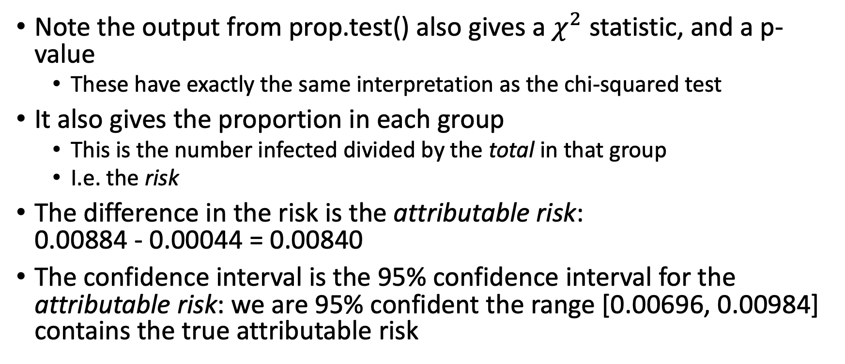
Interpreting the output from prop.test()
Note the output from prop.test() also gives a $χ^{2}$ statistic, and a p-value
  These have exactly the same interpretation as the chi-squared test
It also gives the proportion in each group
  This is the number infected divided by the total in that group
  I.e. the risk
The difference in the risk is the attributable risk:
0.00884 - 0.00044 = 0.00840
The confidence interval is the 95% confidence interval for the attributable risk: we are 95% confident the range [0.00696, 0.00984] contains the true attributable risk

Slide 23
Note on odds ratio and FDA requirements for EUA
As a side note, the Federal Drug Administration (FDA) requires that the vaccine is at least 50% effective in order to grant emergency use authorization (EUA)
To be 50% effective, the odds in the vaccinated group must be 50% or less than the odds in the placebo group
So the odds ratio (placebo/vaccinated) must be greater than 2
The 95% confidence interval for the odds ratio was [10.04, 47.8]
So we are 95% confident the vaccine is at least 90% effective

Slide 24
Summary
To perform a hypothesis test to see if a single proportion is different to some fixed value, use prop.test(…) specifying the value, total, and the assumed fixed proportion
To compare two proportions, favor using Fisher's Exact Test (fisher.test(…) in R)
If fisher.test(…) cannot run, use chisq.test(…)
  In this case you can also use prop.test(…) with two proportions, which generates more information
Be careful! fisher.test(…) and chisq.test(…) expect a matrix with the contingency table; prop.test(…) expects the value(s) and total(s).

