Slide 1
Introduction to Hypothesis Testing or: “Everything you think you know about p-values is wrong”
BMR 617
James Denvir, Ph.D.
March 16th 2021

Slide 2
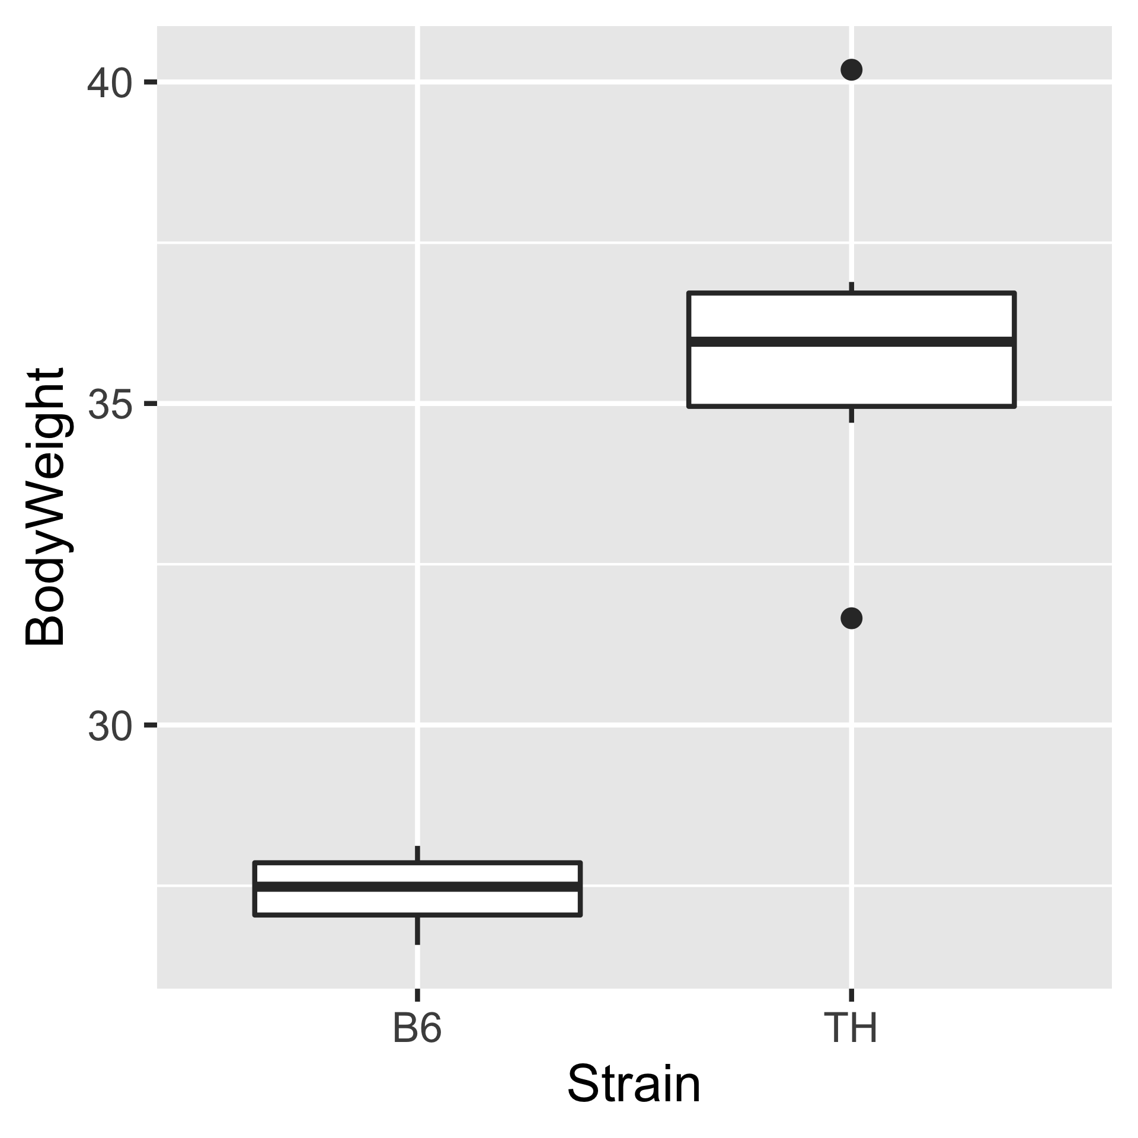
Example
Remember our data from last time
  Two strains of mice (B6 and TH) were fed three different diets
  Measures were taken of body weight and glucose
First, let’s just look at body weight of the two groups of mice fed the standard Chow diet

Slide 3
Code to produce image
library(dplyr)
library(tidyr)
library(ggplot2)
bw.glu <- read.csv("https://denvirlab.marshall.edu/BMR617-2020/data/TH-B6-BodyWeight-Glucose.csv")
bw.glu <- separate(bw.glu, Mouse_ID,
into=c("Strain", "Diet"), sep="-",
remove=F, extra = "drop")
png('bw-strain.png', width=4*480, height=4*480, res=8*72)
ggplot(data = filter(bw.glu, Diet=='Chow’),
aes(x=Strain, y=BodyWeight)) +
geom_boxplot()
dev.off()

Slide 4
Hypothesis testing
Statistical hypothesis testing is
Assessing evidence provided by the data in favor of or against some claim about the population
In this example, we are going to test the hypothesis that the strain affects body weight, i.e. that the body weight is different in different strains
Hypothesis testing is always formulated as testing two competing hypotheses. Generally speaking:
  The null hypothesis is the “default”; i.e. the hypothesis we would tend to conservatively believe without any evidence to the contrary
  The alternative hypothesis is (typically) the hypothesis we want to prove
The null and alternative hypotheses should be mutually exclusive and exhaustive (i.e. one and only one of them is true)

Slide 5
Hypothesis testing: example
In our example, the null hypothesis is
  There is no difference in body weight between the B6 and TH strains on the chow diet
The alternative hypothesis is
  The body weights of TH mice fed the chow diet are different to the body weights of B6 mice fed the chow diet
Note that one of these two must be true

Slide 6
Hypothesis testing: theoretical and philosophical considerations
Note that our data cannot prove beyond any doubt that the alternative hypothesis is true
The hypothesis concerns the entire population (all possible TH and B6 mice)
We only have data from a small sample
Since the data vary, even if the null hypothesis is true, there is always some chance that we just happened to sample one group of data predominantly from one side of the distribution, and one group of data from the other

Slide 7
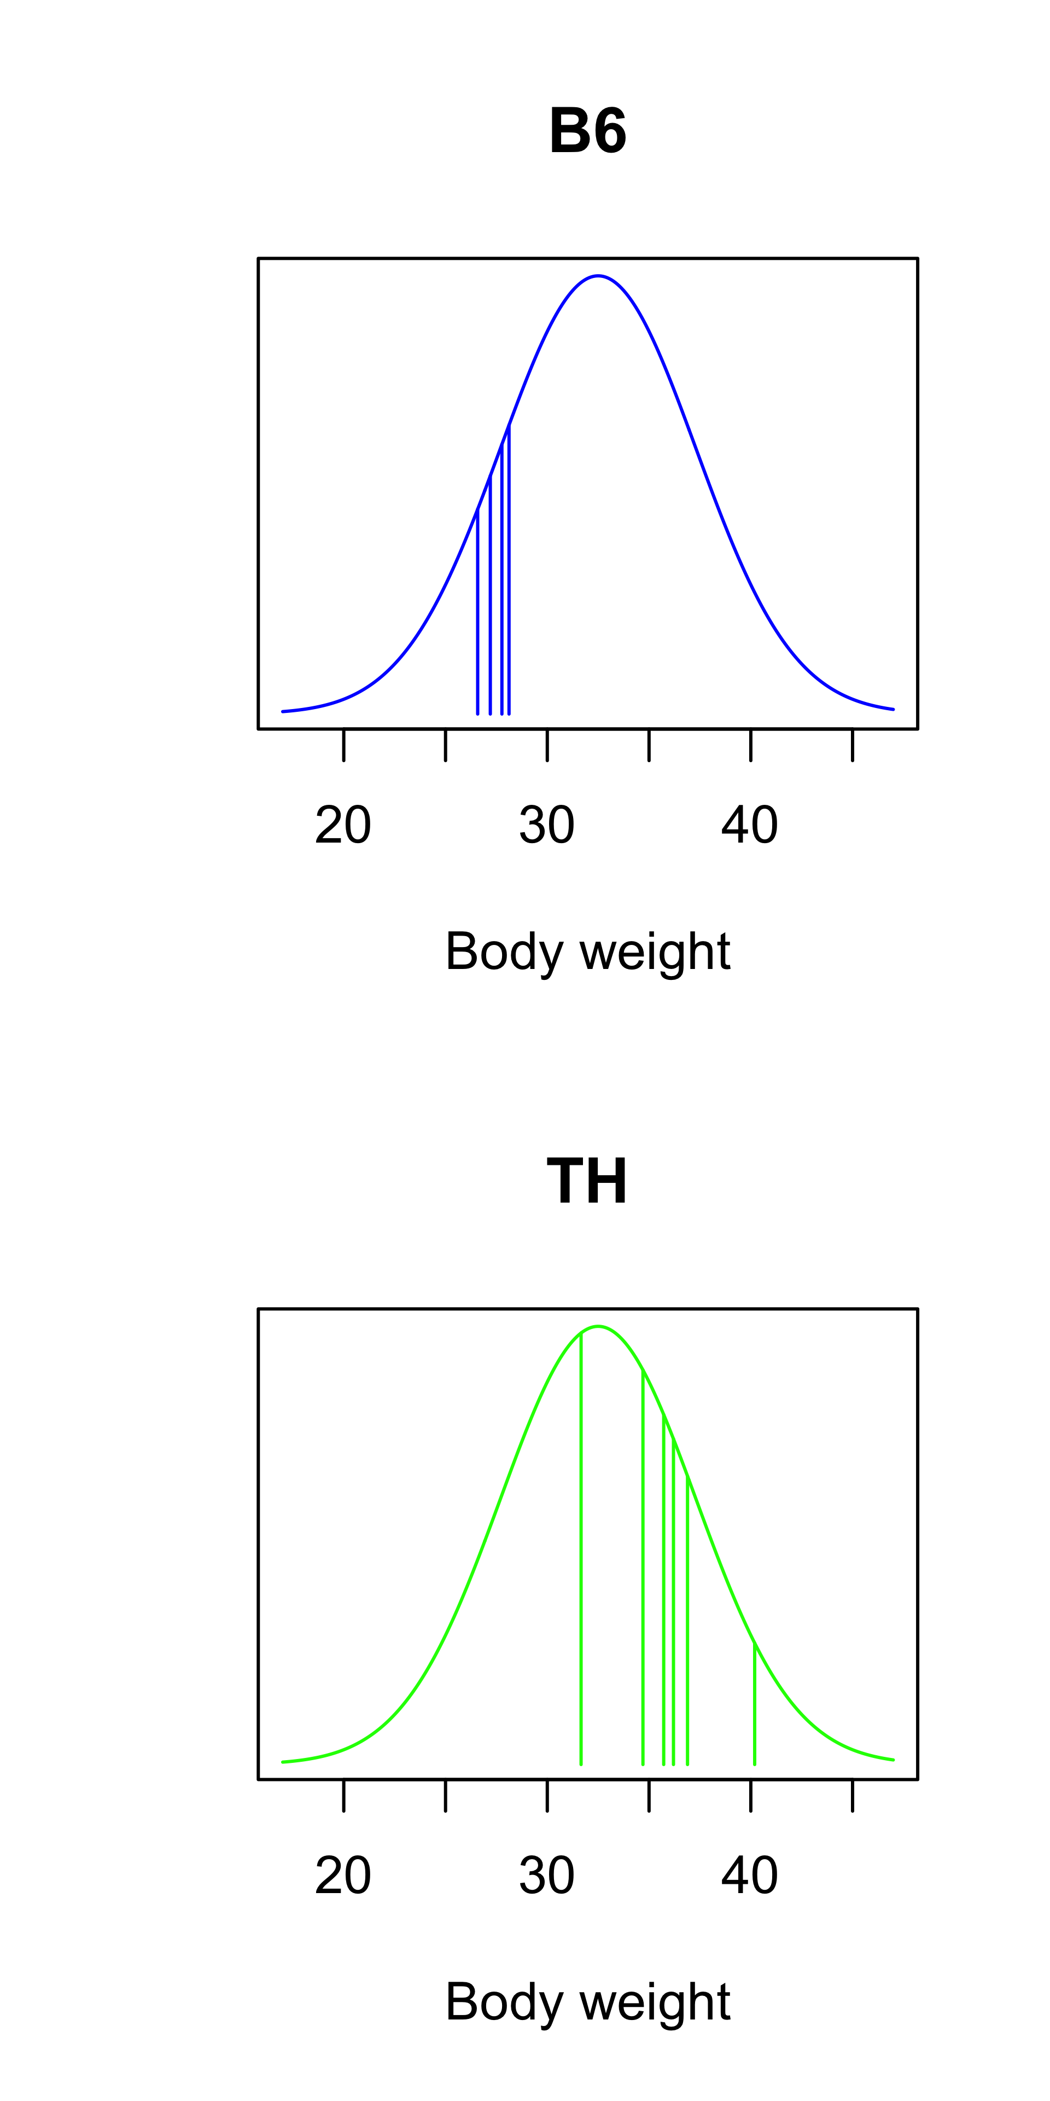
Null hypothesis is possible
Even with our data, the null hypothesis is possible
In the graphs, which illustrate the null hypothesis, the mean (population) body weight of both strains is around 32.5g
In this scenario, it just happened that our B6 samples came from the left of the distribution, and our TH samples came from the right of the distribution
Essentially, we are interested in how likely this scenario is (or isn’t)
  Unfortunately, we can’t actually measure this!

Slide 8
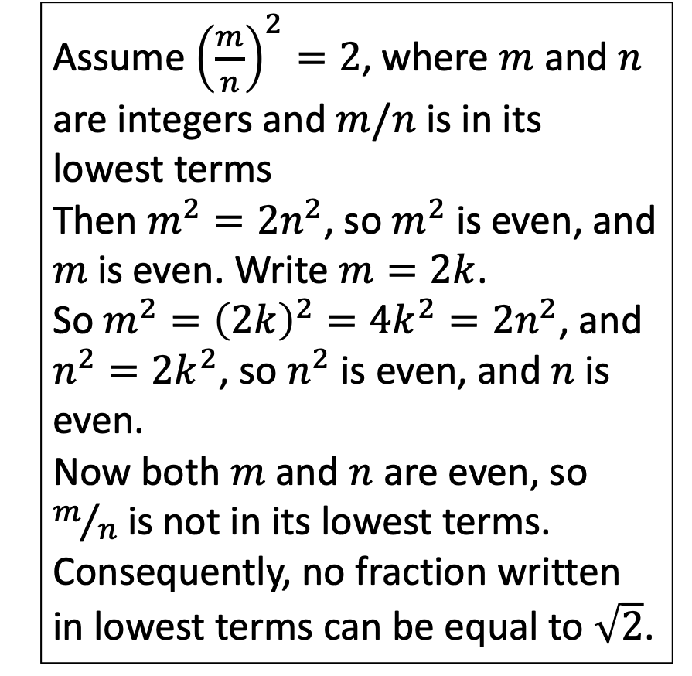
Aside: mathematical proof
Assume ${\left(\frac{m}{n}\right)}^{2}=2$, where $m$ and $n$ are integers and $m/n$ is in its lowest terms
Then $m^{2}=2n^{2}$, so $m^{2}$ is even, and $m$ is even. Write $m=2k$.
So $m^{2}={\left(2k\right)}^{2}=4k^{2}=2n^{2}$, and
$n^{2}=2k^{2}$, so $n^{2}$ is even, and $n$ is even.
Now both $m$ and $n$ are even, so $m/n$ is not in its lowest terms.
Consequently, no fraction written in lowest terms can be equal to $\sqrt{2}$.
In math, we prove things with complete certainty.
On the right is a proof that no rational number (i.e. no fraction) is equal to the square root of 2
We cannot possibly test all fractions
So our strategy is to assume the statement is false, and show this leads to a contradiction
This is called a “proof by contradiction”

Slide 9
Hypothesis testing: process
In statistical hypothesis testing, we cannot prove anything completely
  Our data are subject to randomness
We can only talk about probabilities
The approach is similar to a “proof” by contradiction:
  We collect data to provide evidence for our hypothesis of interest (the alternative hypothesis)
  We then assume that the null hypothesis is true (i.e. that the hypothesis of interest is false)
  Under this assumption, we calculate how likely it is we would observe data at least as “extreme” as the data we actually observed
  If this probability is small, we reject the null hypothesis and conclude that the alternative hypothesis is true

Slide 10
The p-value
In hypothesis testing, we calculate the probability that, assuming the null hypothesis is true, we would obtain data at least as extreme as the data we observe
For example, in the B6 vs TH body weights, under the Chow diet, the mean body weight for B6 mice is 27.4g and for TH mice is 35.9g. The difference is 8.5g.
So when we calculate the p-value, we are asking the question: “If the body weights of B6 and TH mice came from distributions with the same mean, what is the probability we would see a difference of 8.5g in our samples?”

Slide 11
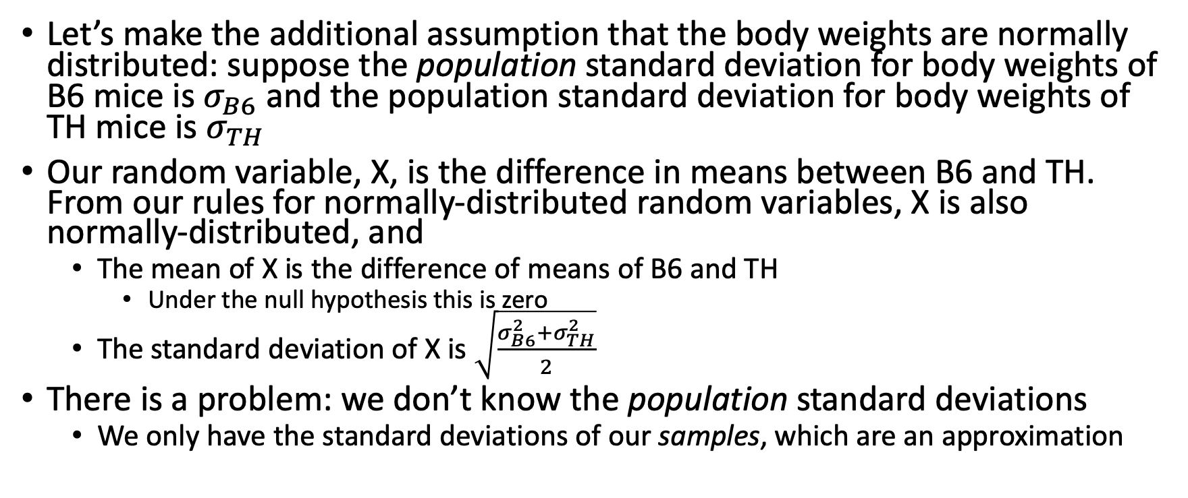
Typical strategy
Let’s make the additional assumption that the body weights are normally distributed: suppose the population standard deviation for body weights of B6 mice is $σ_{B6}$ and the population standard deviation for body weights of TH mice is $σ_{TH}$
Our random variable, X, is the difference in means between B6 and TH. From our rules for normally-distributed random variables, X is also normally-distributed, and
  The mean of X is the difference of means of B6 and TH
    Under the null hypothesis this is zero
  The standard deviation of X is $\sqrt{\frac{σ_{B6}^{2}+σ_{TH}^{2}}{2}}$
There is a problem: we don’t know the population standard deviations
  We only have the standard deviations of our samples, which are an approximation

Slide 12
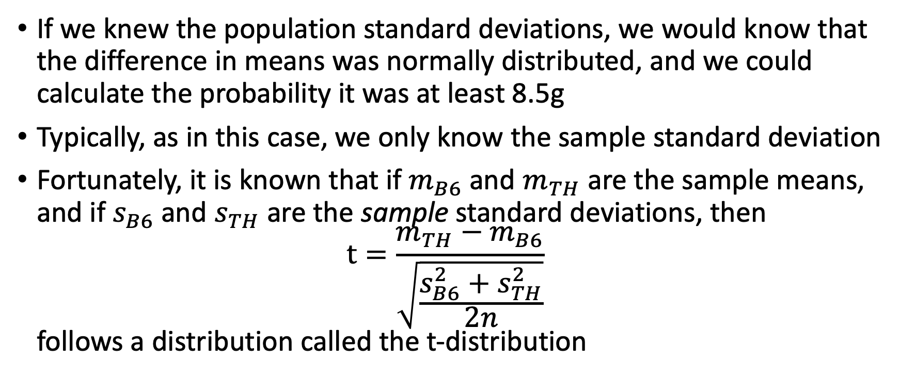
The t-distribution
If we knew the population standard deviations, we would know that the difference in means was normally distributed, and we could calculate the probability it was at least 8.5g
Typically, as in this case, we only know the sample standard deviation
Fortunately, it is known that if $m_{B6}$ and $m_{TH}$ are the sample means, and if $s_{B6}$ and $s_{TH}$ are the sample standard deviations, then
$t=\frac{m_{TH}−m_{B6}}{\sqrt{\frac{s_{B6}^{2}+s_{TH}^{2}}{2n}}}$
follows a distribution called the t-distribution

Slide 13
The t-distribution
The t-distribution is really a family of distributions
  The actual distribution depends of a degree of freedom
  For a single variable this is one less than the sample size
Knowing the distribution, we can calculate the p-value
  Remember, this is the probability that we would get a difference of at least 8.5g between the two groups of sample, if the groups were drawn from populations of equal means
  Another way to think about it is this: even if the body weights of B6 and TH mice were the same, our means would be different just by sampling. How likely is it we would see the difference we actually saw
The calculation of this p-value is called a t-test (sometimes a “Student’s t-test”) after the distribution

Slide 14
T-test in R
R has a t.test function
Try the following:
bw.glu <-
read.csv("https://denvirlab.marshall.edu/BMR617-2020/data/TH-B6-BodyWeight-Glucose.csv")
colnames(bw.glu)[[1]] <- "Mouse_ID”
bw.glu.chow <- bw.glu[grep("Chow", bw.glu$Mouse_ID),]
bw.glu.chow$Strain <- substr(x = bw.glu.chow$Mouse_ID, start=1, stop=2)
t.test(BodyWeight ~ Strain, data=bw.glu.chow)
What is the p-value?
What are the estimated means? What’s the difference between them?

Slide 15
Interpreting a hypothesis test
Care is needed in interpreting a hypothesis test
Very commonly misinterpreted, even by advanced professional scientists
In our test, the p-value was 0.00043
So, if there were no difference in body weight between B6 and TH mice, there would be only a 0.043% chance of obtaining a difference in means this big with these sample sizes
  Since this is so unlikely, we would reject the null hypothesis and conclude that the two strains had different body weights

Slide 16
P-value thresholds
The natural question here is “how small is a small p-value?”
The standard approach is to choose a threshold, below which we will reject the null hypothesis
  Do this before collecting and analyzing data
Hypothesis testing was invented in the late 1800s by Ronald Fisher
In his original paper, as an example, he used a threshold of 0.05
This has become, for no particularly good reason, a “standard” threshold

Slide 17
Important lesson #1: The p-value is not the probability the null hypothesis is false
The p-value is the probability of obtaining data as extreme as that observed, under the assumption that the null hypothesis holds
This is not the same as the probability that the null hypothesis is true
Commonly mistaken as such
We can almost never compute the probability the null hypothesis is true

Slide 18
An imaginary scenario
Prof. Cavendish O’Leary (“Cav”) runs a lab in the Institute for Unlikely Discoveries. Over the course of his career, he conducts 1000 studies. His ambition is to discover something that will make him famous and chooses studies that, if successful, will be groundbreaking and paradigm shifting in the field.
Prof. Prudence Dent (“Pru”) runs a lab in the Institute for the Establishment of Known Facts. Over the course of her career, she also conducts 1000 studies. Her aim in life is to build a steady body of solid, reproducible publications, and as such she only studies things with an abundance of solid evidence.

Slide 19
The a-priori probability
Because Cav O’Leary and Pru Dent exist only in a fictional universe, of which we are the creators and omnipotent beings, we know that 2% of the hypotheses that Prof. O’Leary tests are really true, and that 90% of the hypotheses that Prof. Dent tests are really true
  These values are called the “a-priori” probabilities of the hypotheses, and these are never known in the real world
Both Prof. O’Leary and Prof. Dent use a p-value threshold of 0.05 to determine “statistical significance” (i.e. decide whether or not to reject the null hypothesis)
Furthermore, both design their experiments and choose their sample sizes to give a statistical power of 80%: if their hypothesis is true, there is an 80% chance they will get a p-value less than the threshold
Suppose Pru Dent performs an experiment and rejects the null hypothesis. What is the probability that the null hypothesis is false? What about Cav O’Leary?

Slide 20
Pru Dent computation
 |  | Reject null hypothesis
 |  | No | Yes | Total
Null hypothesis really true | Yes
 | No
 | Total |  |  | 1000
Dr. Dent performs 1000 experiments in her career

Slide 21
Pru Dent computation
 |  | Reject null hypothesis
 |  | No | Yes | Total
Null hypothesis really true | Yes |  |  | 100
 | No |  |  | 900
 | Total |  |  | 1000
In 90% of the experiments, her hypothesis is true (a-priori probability, unknown in reality)

Slide 22
Pru Dent computation
 |  | Reject null hypothesis
 |  | No | Yes | Total
Null hypothesis really true | Yes |  |  | 100
 | No | 180 | 720 | 900
 | Total |  |  | 1000
When the null hypothesis is false, there is an 80% chance of correctly rejecting it (statistical power)

Slide 23
Pru Dent computation
 |  | Reject null hypothesis
 |  | No | Yes | Total
Null hypothesis really true | Yes | 95 | 5 | 100
 | No | 180 | 720 | 900
 | Total |  |  | 1000
If the null hypothesis is true, there is a 0.05 chance of incorrectly rejecting it (definition of p-value and choice of threshold)

Slide 24
Pru Dent computation
 |  | Reject null hypothesis
 |  | No | Yes | Total
Null hypothesis really true | Yes | 95 | 5 | 100
 | No | 180 | 720 | 900
 | Total | 275 | 725 | 1000
Complete column totals: Dr. Dent rejects the null hypothesis 725 times out of her 1000 experiments, and fails to reject it 275 times

Slide 25
Pru Dent computation
 |  | Reject null hypothesis
 |  | No | Yes | Total
Null hypothesis really true | Yes | 95 | 5 | 100
 | No | 180 | 720 | 900
 | Total | 275 | 725 | 1000
Out of the 725 times Dr. Dent rejects the null hypothesis, that is a correct decision 720 times. So if she rejects the null hypothesis, the probability her hypothesis is true is 720/725 = 0.993

Slide 26
Cav O’Leary computation
 |  | Reject null hypothesis
 |  | No | Yes | Total
Null hypothesis really true | Yes
 | No
 | Total |  |  | 1000
Dr. O’Leary performs 1000 experiments in his career

Slide 27
Cav O’Leary computation
 |  | Reject null hypothesis
 |  | No | Yes | Total
Null hypothesis really true | Yes |  |  | 980
 | No |  |  | 20
 | Total |  |  | 1000
Only 2% of Dr. O’Leary’s hypotheses are actually true

Slide 28
Cav O’Leary computation
 |  | Reject null hypothesis
 |  | No | Yes | Total
Null hypothesis really true | Yes |  |  | 980
 | No | 4 | 16 | 20
 | Total |  |  | 1000
When the null hypothesis is false, there is an 80% chance of correctly rejecting it (statistical power)

Slide 29
Cav O’Leary computation
 |  | Reject null hypothesis
 |  | No | Yes | Total
Null hypothesis really true | Yes | 931 | 49 | 980
 | No | 4 | 16 | 20
 | Total | 935 | 65 | 1000
Complete column totals: Dr. O’Leary rejects the null hypothesis 65 times out of his 1000 experiments, and fails to reject it 935 times

Slide 30
Cav O’Leary computation
 |  | Reject null hypothesis
 |  | No | Yes | Total
Null hypothesis really true | Yes | 931 | 49 | 980
 | No | 4 | 16 | 20
 | Total | 935 | 65 | 1000
Out of the 65 times Dr. O’Leary rejects the null hypothesis, that is a correct decision 16 times. So if he rejects the null hypothesis, the probability his hypothesis is true is 16/65 = 0.246

Slide 31
Conclusions
Many people assume that if we reject the null hypothesis (with a p-value threshold of 0.05), it means there is a 95% chance the null hypothesis is false (i.e. that the hypothesis of interest is true)
This fictional scenario demonstrates this is not true
The probability the null hypothesis is false, given we have a p-value less than 0.05, depends greatly on the a-priori probability
  The prior probability that the null hypothesis was false
  The problem is, again, that we never actually know this
In our (somewhat extreme) examples, the probabilities we calculated were 0.993, and 0.246,respectively.

Slide 32
Important lesson #2: A “non-significant” p-value doesn’t lead to any conclusion
In the hypothesis-testing scenario, we choose a p-value threshold (below which we reject the null hypothesis)
We then collect data and perform our analysis, computing the p-value
If the p-value is below the threshold, we reject the null hypothesis and conclude the hypothesis of interest is correct
If the p-value is above the threshold, we simply fail to reject the null hypothesis
  Notice here that we don’t draw any conclusion
  We certainly cannot conclude the null hypothesis is true

Slide 33
P > 0.05 is often misinterpreted
This last point is very commonly misunderstood
It is very common to see statements, even in published papers, like
“There was no difference in the blood pressures of patients on drug A or drug B (p>0.05)”
  This is not a valid conclusion from a “non-small” p-value!
  At best, you can conclude that the experiment or study failed to demonstrate a difference

Slide 34
The Frequentist versus Bayesian argument
The hypothesis-testing approach is known as the “Frequentist” approach to statistics
  How frequently would we get data like this if the null hypothesis were true
Advantages include the fact that it is unbiased
  Computation of the p-value doesn’t rely on any guess work or subjective evaluation of the veracity of the hypothesis
Disadvantage is that it doesn’t really tell us what we want to know:
  We want to know the probability the null hypothesis is true
The approach we demonstrated in the tables is known as the “Bayesian” approach
  Essentially uses Bayes theorem to “update” the probability the null hypothesis is true in light of the data we observe
Advantage is that it’s closer to the question we really want to answer
Disadvantage is that we need an initial, subjective, estimate of that probability

Slide 35
Frequentists are still winning
The frequentist approach is still, by far, the most prominent in scientific literature
  Particularly in biomedical sciences
Both approaches have their merits and sometimes it is useful to use tools from each
We will spend some time examining hypothesis testing, but bear in mind the limitations
  We will see more scenarios where we have to be careful how to interpret p-values later

Slide 36
Further reading
In March 2019, the American Statistical Association published a special edition of their journal, The American Statistician, addressing misunderstandings of hypothesis testing and p-values
https://www.tandfonline.com/toc/utas20/73/sup1
  Read (as a minimum) the editorial from this issue
Nature published an accompanying article, signed by 800 academic and professional statisticians
  https://www.nature.com/articles/d41586-019-00857-9
The key point these articles make is to stop categorizing and dichotomizing results based solely on p-values
  Instead, thoughtfully assess all the data and analyses

