Slide 1
BMR 617
Correlation
March 9th 2021

Slide 2
Q →Q case
So far we have seen examples where both the explanatory variable and the response variable are categorical (C → C)
  Vaccine example
  Use contingency tables, look at relative risk, etc.
And where the explanatory variable is categorical and the outcome is quantitative (C → Q)
  Mouse data
  Use boxplots, column scatter plots and/or bar charts
  Measure mean, standard deviation, standard error of the mean, etc.
Now we'll consider the case where both the explanatory variable and the response variable are quantitative (Q → Q)

Slide 3
Example
Borkman et al. (New England Journal of Medicine, 1993) studied the relationship between insulin sensitivity and lipid composition of the cell membrane
They measured insulin sensitivity of 13 healthy men by infusing insulin and measuring how much glucose they needed to infuse to maintain a constant blood glucose level
The also took skeletal muscle biopsies and measured (among other things) the percentage of polyunsaturated fatty acids that had between 20 and 22 carbon atoms (%C20-22).

Slide 4
Data
Insulin sensitivity (mg/m²/min) | %C20-22 polyunsaturated fatty acids
250 | 17.9
220 | 18.3
145 | 18.3
115 | 18.4
230 | 18.4
200 | 20.2
330 | 20.3
400 | 21.8
370 | 21.9
260 | 22.1
270 | 23.1
530 | 24.2
375 | 24.4

Slide 5
Variability
Both these variables show a degree of variability:

Slide 6
Covariability or Correlation
If we plot both variables together in a scatterplot, we see that the variation is "shared" between the variables
library(tidyverse)
ins <- read_csv("https://denvirlab.marshall.edu/BMR617-2021/data/InsulinSensitivityBorkman.csv")
ggplot(ins, aes(x=`%C20-22`, y=InsulinSensitivity)) + geom_point()
Individuals who have more C20-22 polyunsaturated fatty acids tend to have higher insulin sensitivity
We say there is a lot of covariability or correlation
The variables "vary together"

Slide 7
The correlation coefficient
The amount of correlation can be quantified by a correlation coefficient
The correlation coefficient between two sets of values x₁…x_{n} and y₁…y_{n} is computed as follows:
  Calculate the standardized values of x and y:
  z_{x,i}=(x_{i}-mean(x))/sd(x); z_{y,i}=(y_{i}-mean(y))/sd(y);
  Compute the products of all the standardized values, add them up, and divide by n-1:
  r=(z_{x,1}z_{y,1}+z_{x,2}z_{y,2}+…+z_{x,n}z_{y,n})/(n-1)

Slide 8
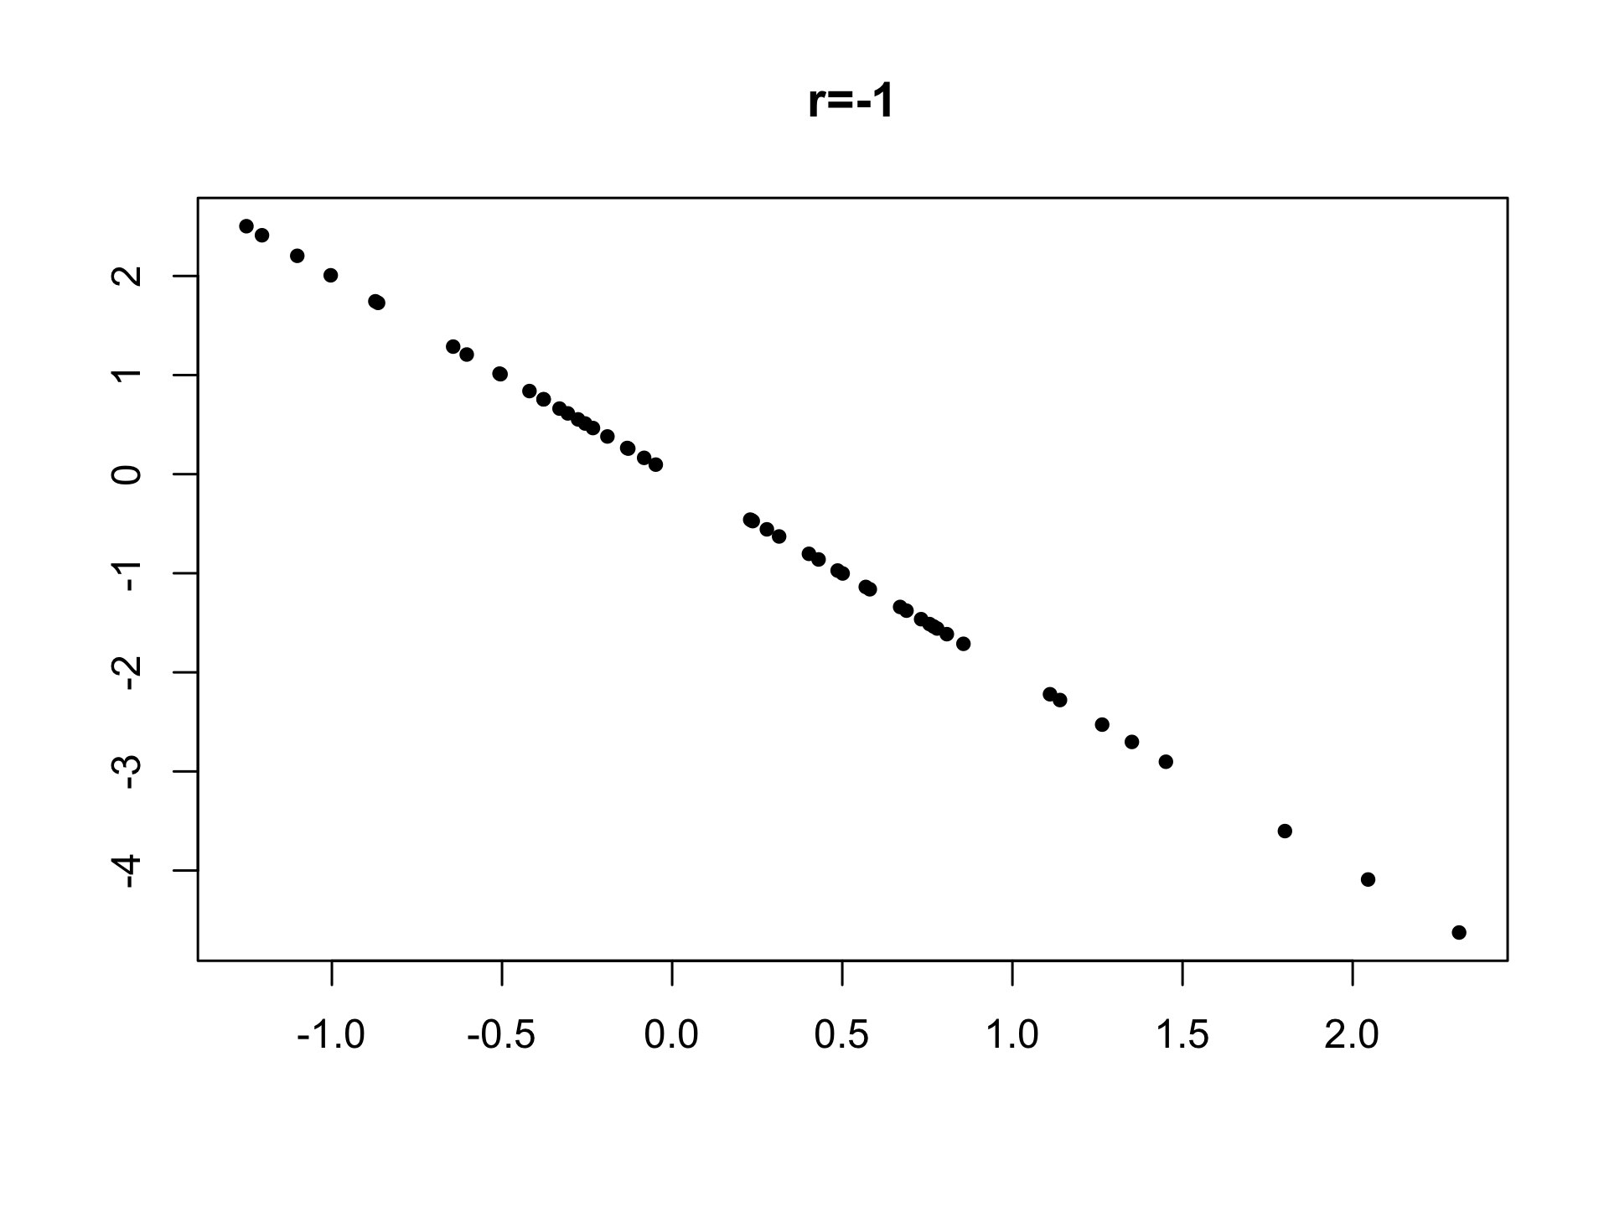
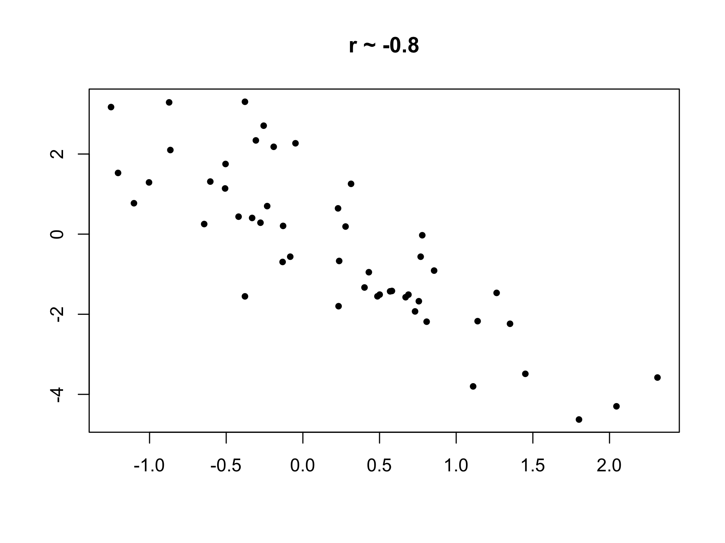
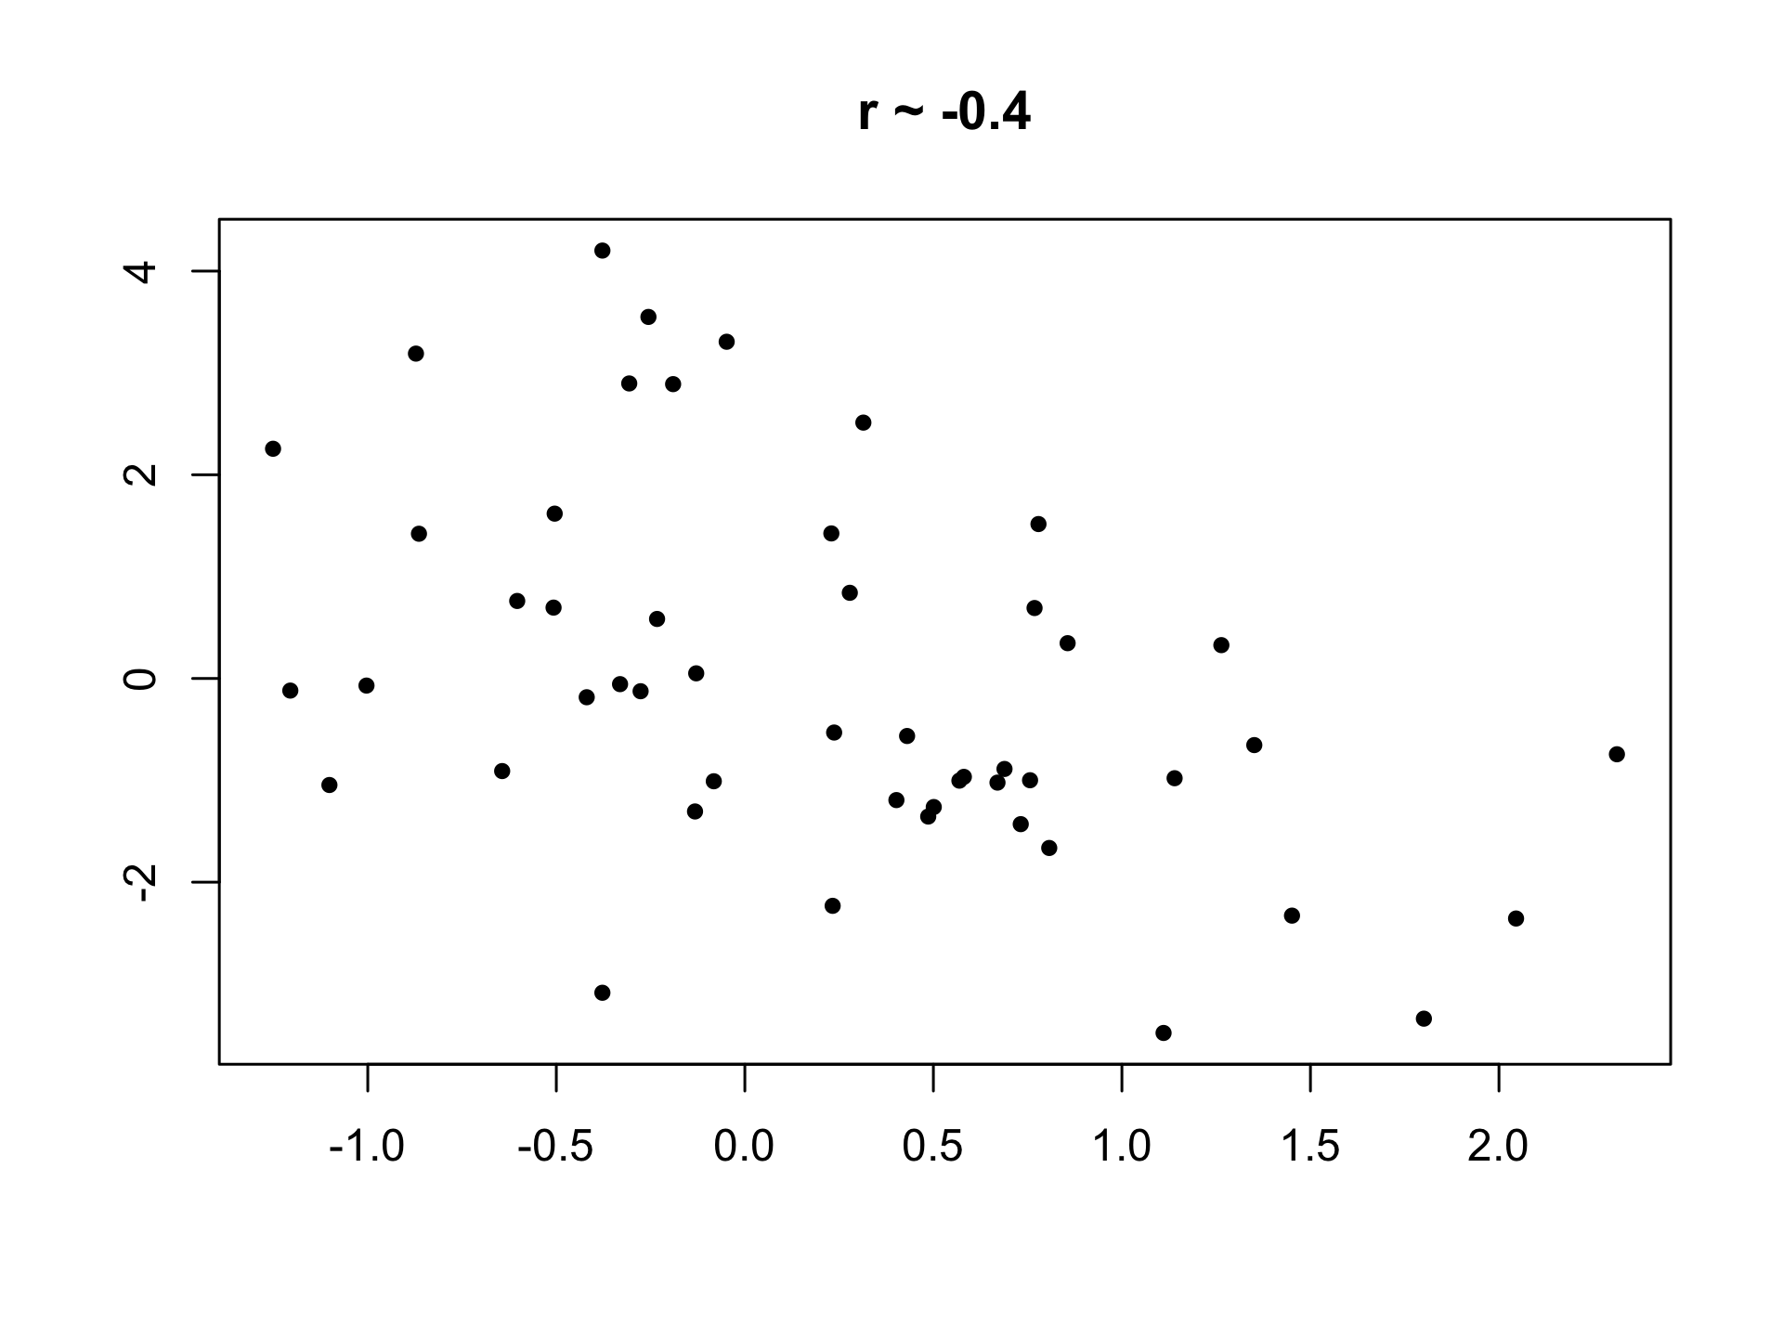
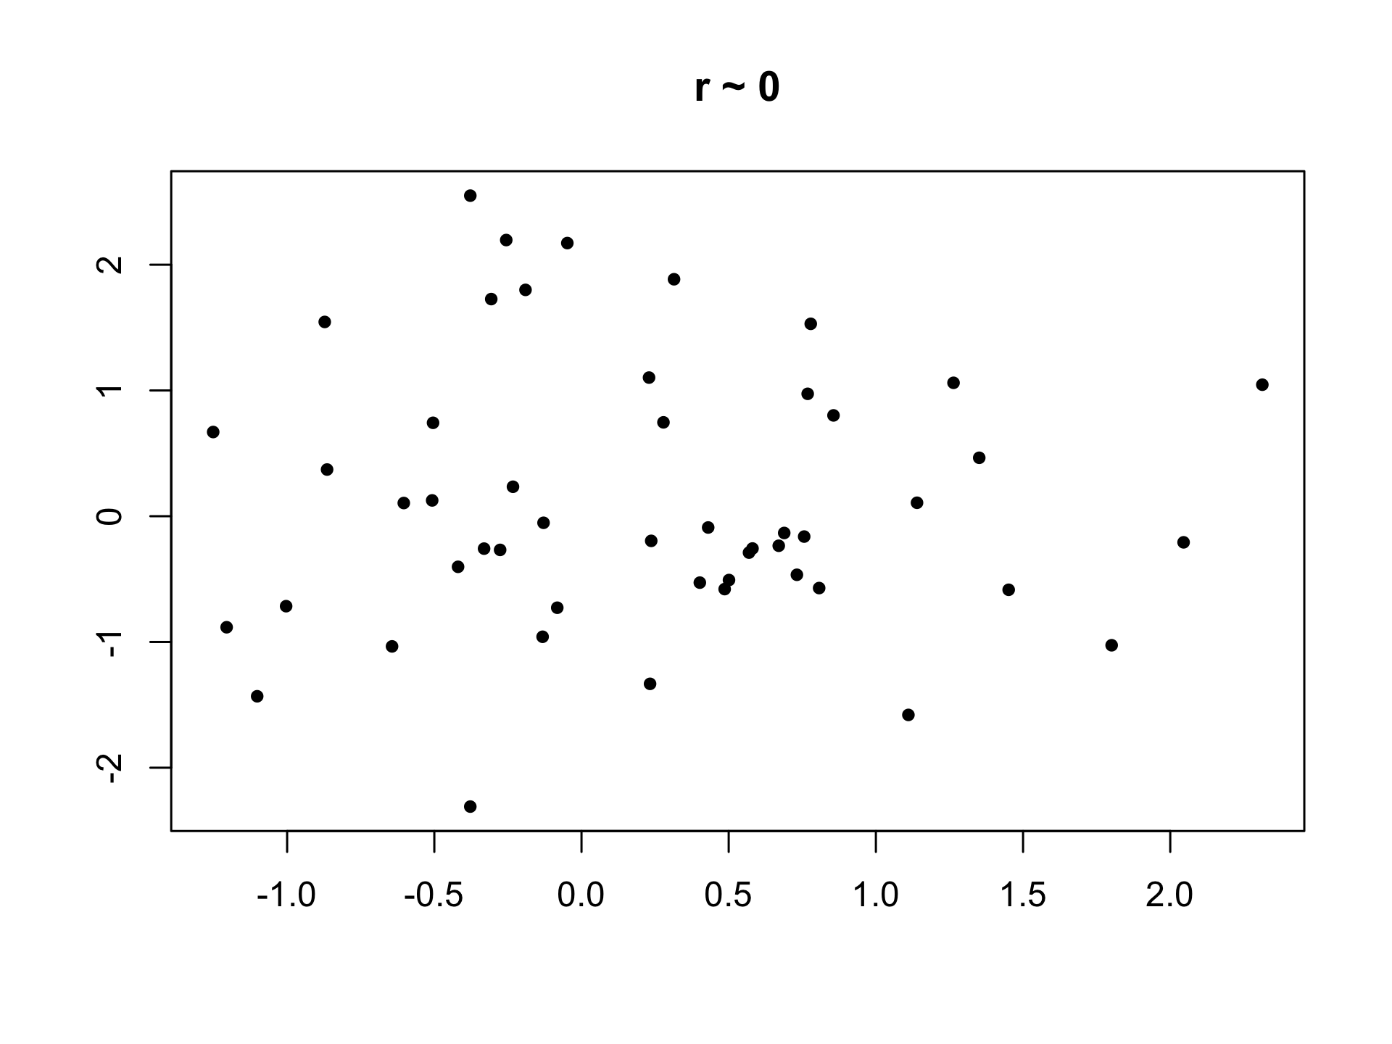
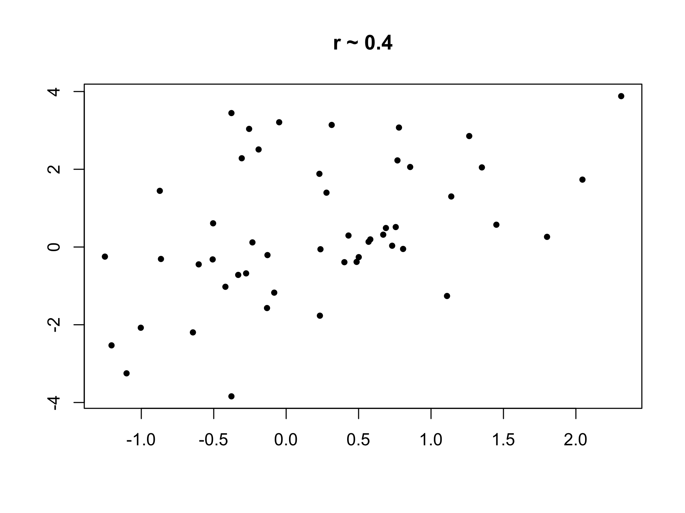
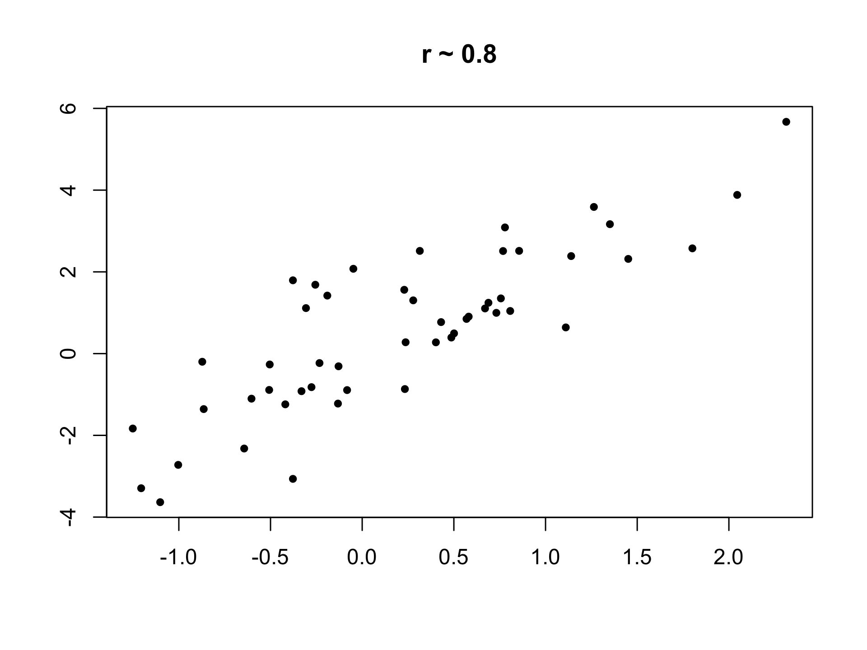
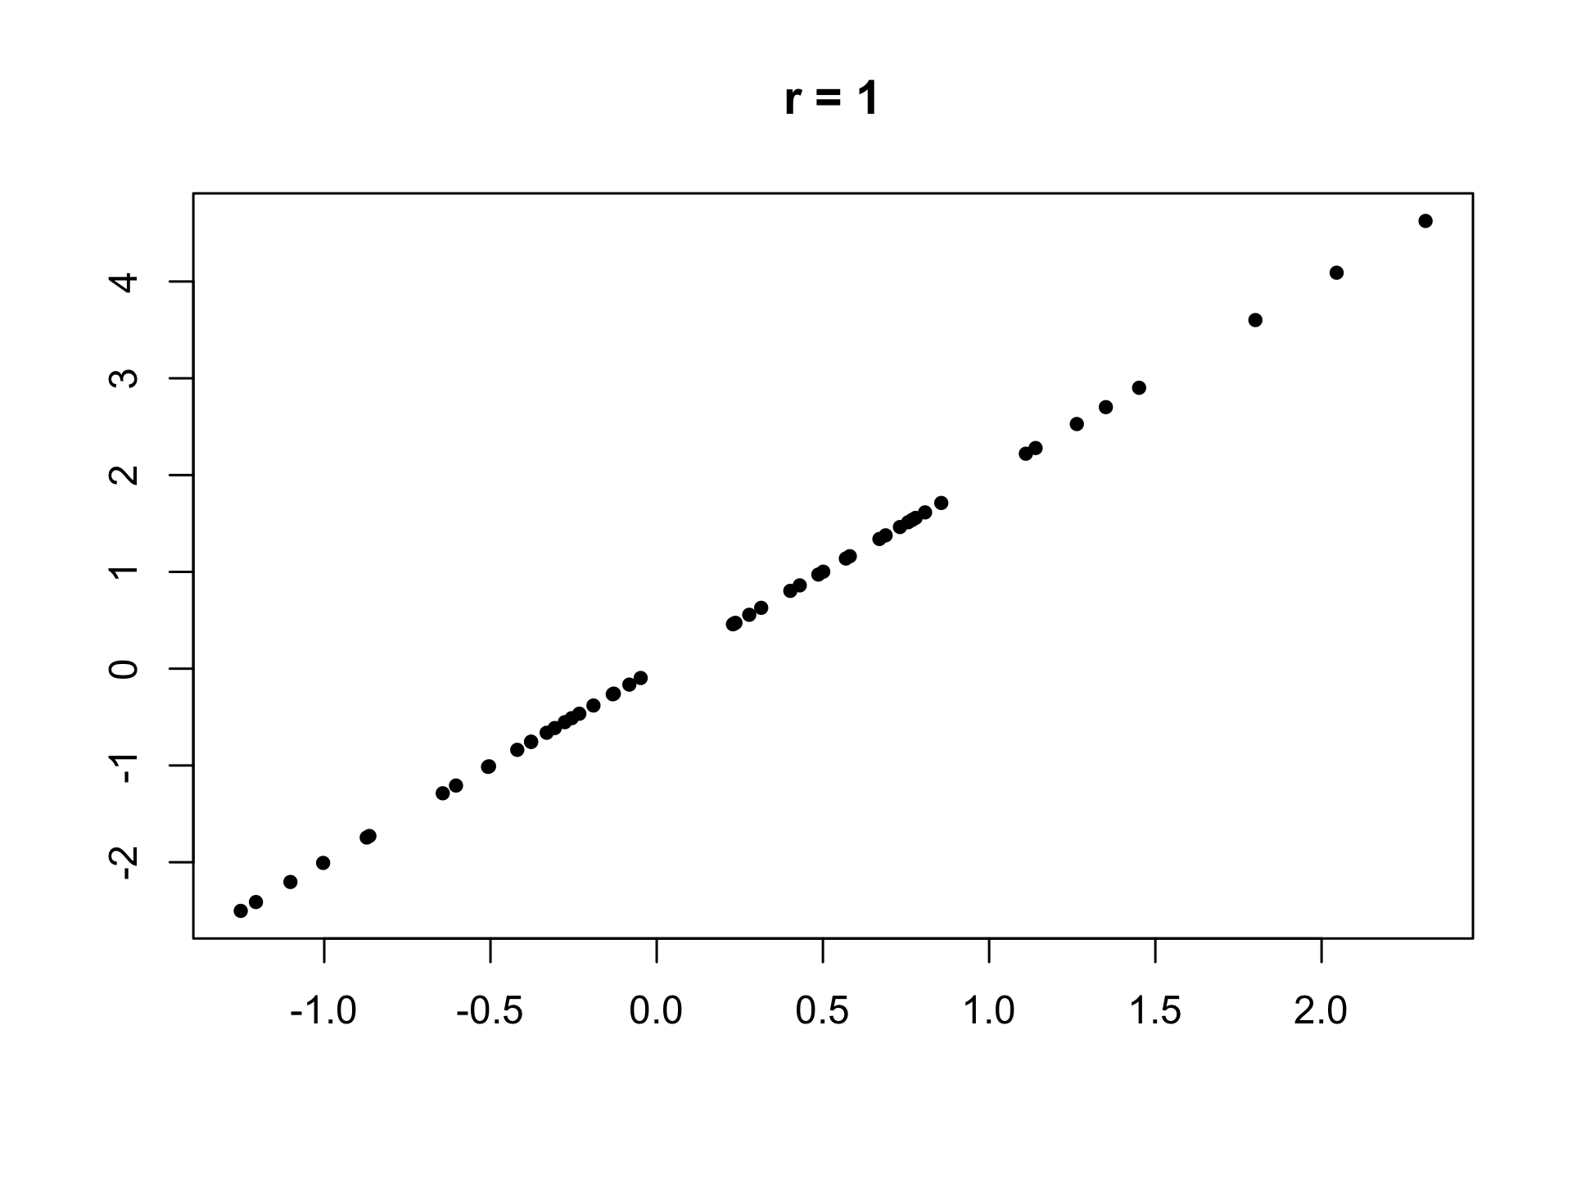
Correlation
The correlation coefficient between a set of pairs of quantitative values is a measure of the strength of a linear relationship between them
  0 means no linear relationship
  1 means a perfect positive linear relationship
  -1 means a perfect negative linear relationship

Slide 9
Why the correlation coefficient works
If a value is bigger than the mean, its standardized score is positive, otherwise its standardized score is negative
The product of two standardized scores will be positive if both scores are positive, or both scores are negative i.e. if both scores are bigger than the mean, or both are less than the mean
So if one variable tends to increase when the other tends to increase, the bulk of the products of standardized scores will be positive, and the correlation coefficient will be high
On the other hand, if one variable tends to decrease when the other increases, the bulk of the products of standardized scores will be negative, and the correlation coefficient will be low
If there is no relationship, the standardized scores will be randomly distributed, and their products will tend to cancel out

Slide 10
Computing the correlation coefficient in R
In R, we can do the following:
cor(pull(ins, `%C20-22`), pull(ins, InsulinSensitivity))
The correlation coefficient for these data is 0.77
This indicates a strong positive correlation between the two variables

Slide 11
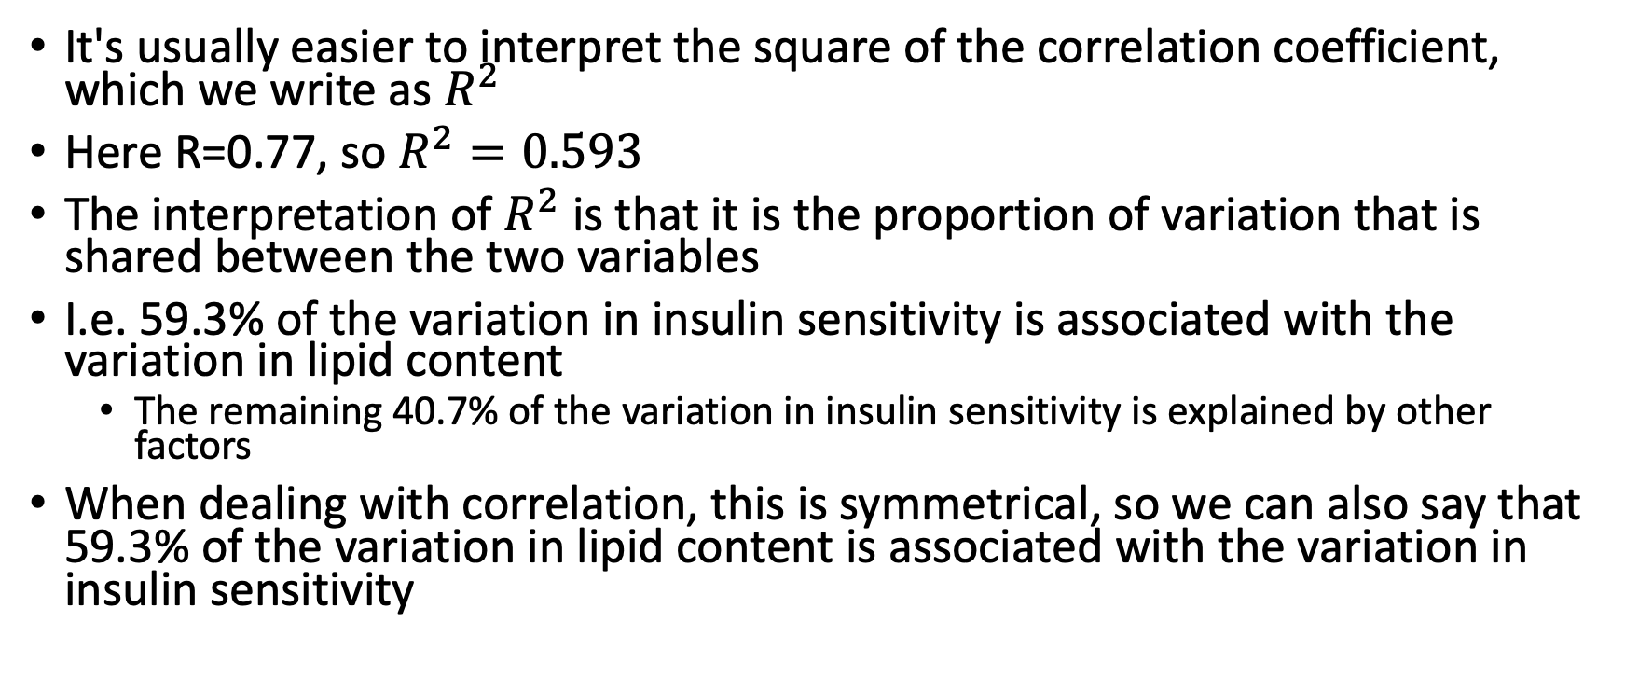
Interpreting the correlation coefficient
It's usually easier to interpret the square of the correlation coefficient, which we write as $R^{2}$
Here R=0.77, so $R^{2}=0.593$
The interpretation of $R^{2}$ is that it is the proportion of variation that is shared between the two variables
I.e. 59.3% of the variation in insulin sensitivity is associated with the variation in lipid content
  The remaining 40.7% of the variation in insulin sensitivity is explained by other factors
When dealing with correlation, this is symmetrical, so we can also say that 59.3% of the variation in lipid content is associated with the variation in insulin sensitivity

Slide 12
Correlation and Causation
There are several possible explanations of the correlation we observe:
The lipid content of the membranes determines insulin sensitivity
The insulin sensitivity of the membranes affects its lipid content
Both lipid content and insulin sensitivity are under the control of another factor
Lipid content, insulin sensitivity, and several other factors are all part of a complex molecular network.
The two variables don't really correlate, and the observation in this sample was just a coincidence

Slide 13
Which explanation is correct?
We'll learn how to quantify (to some degree) the likelihood of the last possibility later
The only way to decide among the first four options is to do further experiments, where the variables are directly manipulated to see which variable affects which other variable(s)

Slide 14
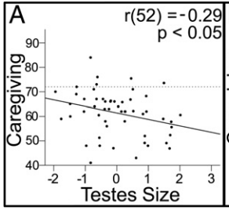
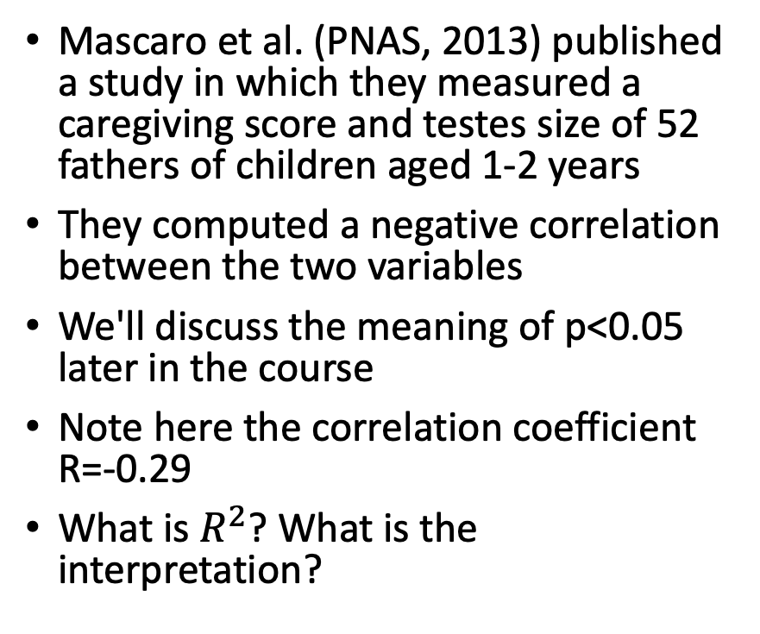
Caution 1: beware of large samples
Mascaro et al. (PNAS, 2013) published a study in which they measured a caregiving score and testes size of 52 fathers of children aged 1-2 years
They computed a negative correlation between the two variables
We'll discuss the meaning of p<0.05 later in the course
Note here the correlation coefficient R=-0.29
What is $R^{2}$? What is the interpretation?

Slide 15
Caution 2: beware of confounding variables
In our mouse data, we could look at correlation between the metabolic variables.
For example, to look at the correlation between Triglycerides and Glucose, we would do:
met <- read_csv("https://denvirlab.marshall.edu/BMR617-2021/data/TH-B6-metabolic.csv")
met <- separate(met, MouseID, sep="-", into=c("Strain", "Diet", "ID"))
cor(pull(met, TG), pull(met, Glucose))
This gives an apparently very strong correlation of 0.878

Slide 16
A closer look at the Triglycerides-Glucose data
Plot the data:
ggplot(met, aes(x=TG, y=Glucose)) +
geom_point(aes(color=Diet, shape=Strain))
The correlation is "driven" by a few data points which have much higher Triglycerides and Glucose
Those data points are all TH mice on either the LF or HF diets
Within any group, there is little to no evidence of correlation
So it is likely that Strain and Diet affect both variables, but otherwise the two are unrelated

