Slide 1
BMR 617
Confidence Interval of a Mean

Slide 2
Confidence Intervals
Remember our framework for confidence intervals:
We gather a sample of data and compute some statistic from it
  In this presentation, this statistic will be the mean
The idea is that this statistic for the sample approximates the population value
We choose a confidence level
  Typically 95%
We compute a range of values that we are 95% confident contains the population value

Slide 3
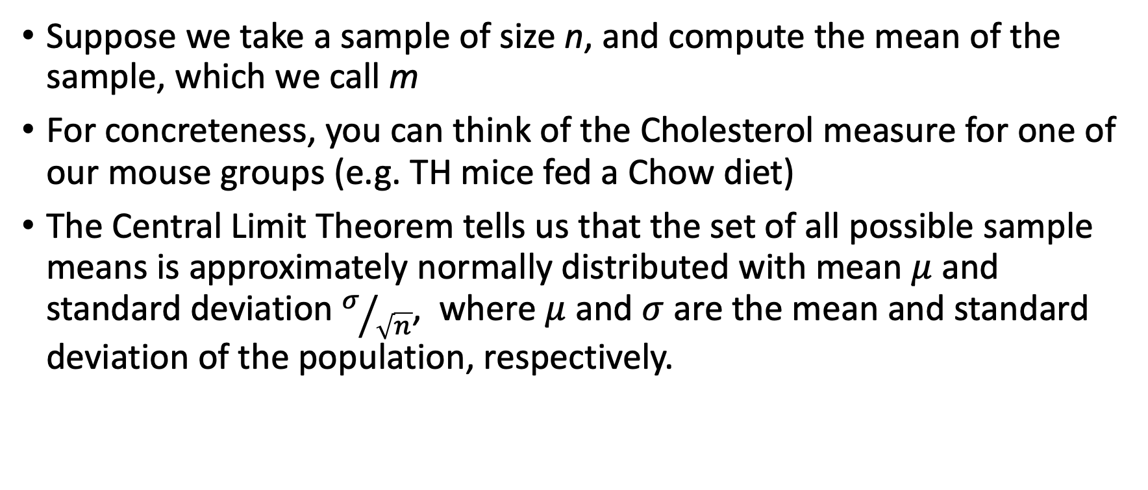
Using the central limit theorem to calculate the confidence interval of a mean
Suppose we take a sample of size n, and compute the mean of the sample, which we call m
For concreteness, you can think of the Cholesterol measure for one of our mouse groups (e.g. TH mice fed a Chow diet)
The Central Limit Theorem tells us that the set of all possible sample means is approximately normally distributed with mean $μ$ and standard deviation $σ/{\sqrt{n}}$, where $μ$ and $σ$ are the mean and standard deviation of the population, respectively.

Slide 4
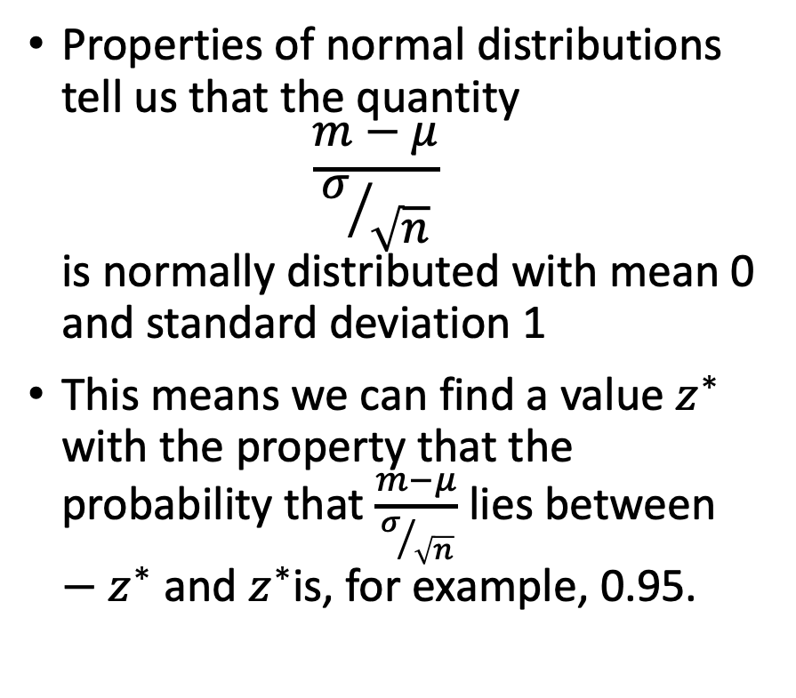
Using the central limit theorem to calculate the confidence interval of a mean
Properties of normal distributions tell us that the quantity
$\frac{m−μ}{σ/{\sqrt{n}}}$
is normally distributed with mean 0 and standard deviation 1
This means we can find a value $z^{∗}$ with the property that the probability that $\frac{m−μ}{σ/{\sqrt{n}}}$ lies between $−z^{∗}$ and $z^{∗}$is, for example, 0.95.

Slide 5
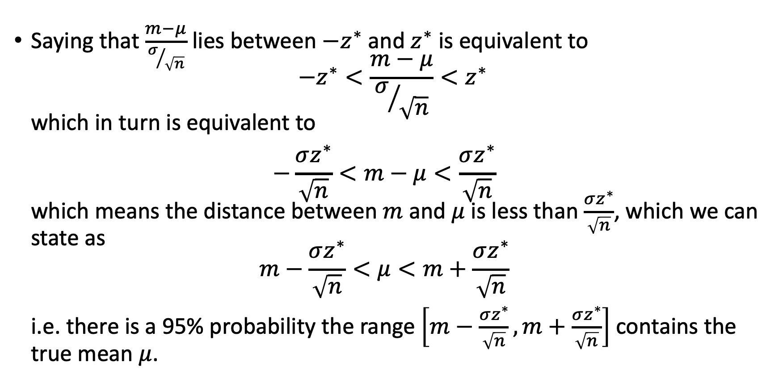
Using the central limit theorem to calculate the confidence interval of a mean
Saying that $\frac{m−μ}{σ/{\sqrt{n}}}$ lies between $−z^{∗}$ and $z^{∗}$ is equivalent to
$−z^{∗}<\frac{m−μ}{σ/{\sqrt{n}}}<z^{∗}$
which in turn is equivalent to
$−\frac{σz^{∗}}{\sqrt{n}}<m−μ<\frac{σz^{∗}}{\sqrt{n}}$
which means the distance between $m$ and $μ$ is less than $\frac{σz^{∗}}{\sqrt{n}}$, which we can state as
$m−\frac{σz^{∗}}{\sqrt{n}}<μ<m+\frac{σz^{∗}}{\sqrt{n}}$
i.e. there is a 95% probability the range $\left[m−\frac{σz^{∗}}{\sqrt{n}}, m+\frac{σz^{∗}}{\sqrt{n}}\right]$ contains the true mean $μ$.

Slide 6


We don’t usually know $σ$
The previous two slides produced a formula for the confidence interval for the mean
However, this formula relied on $σ$, the population standard deviation
We almost never know this

Slide 7
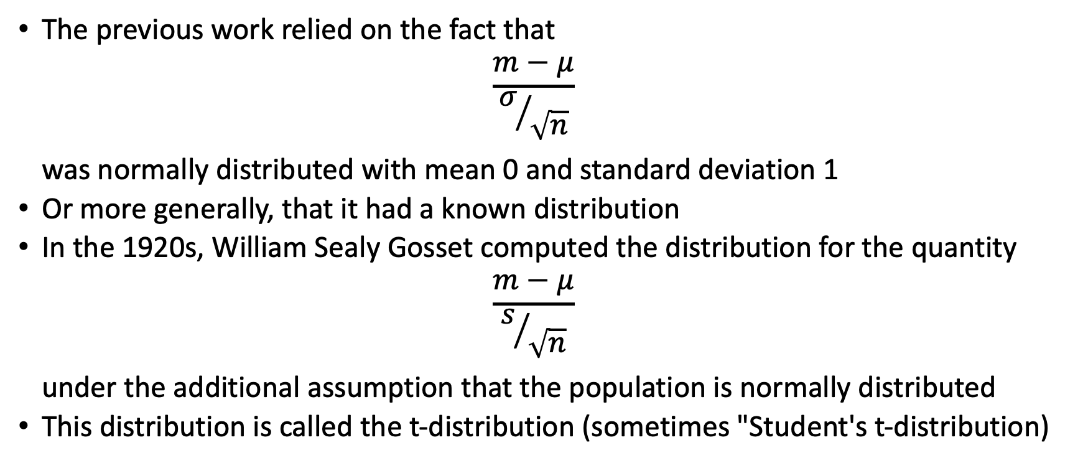
The t-distribution
The previous work relied on the fact that
$\frac{m−μ}{σ/{\sqrt{n}}}$
was normally distributed with mean 0 and standard deviation 1
Or more generally, that it had a known distribution
In the 1920s, William Sealy Gosset computed the distribution for the quantity
$\frac{m−μ}{s/{\sqrt{n}}}$
under the additional assumption that the population is normally distributed
This distribution is called the t-distribution (sometimes "Student's t-distribution)

Slide 8
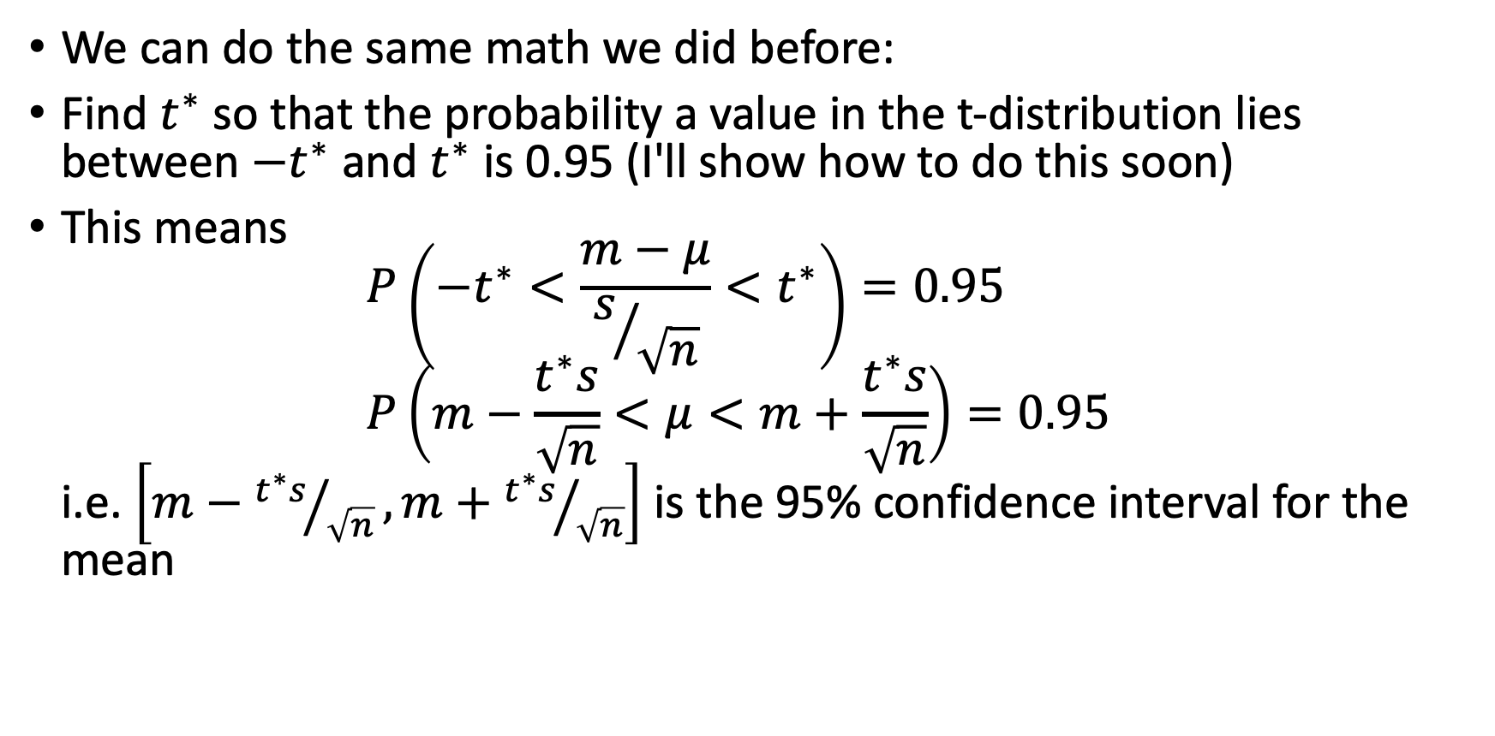
Computing the confidence interval of the mean when the population is normally distributed
We can do the same math we did before:
Find $t^{∗}$ so that the probability a value in the t-distribution lies between $−t^{∗}$ and $t^{∗}$ is 0.95 (I'll show how to do this soon)
This means
$P\left(−t^{∗}<\frac{m−μ}{s/{\sqrt{n}}}<t^{∗}\right)=0.95$
$P\left(m−\frac{t^{∗}s}{\sqrt{n}}<μ<m+\frac{t^{∗}s}{\sqrt{n}}\right)=0.95$
i.e. $\left[m−{t^{∗}s}/{\sqrt{n}}, m+{t^{∗}s}/{\sqrt{n}}\right]$ is the 95% confidence interval for the mean

Slide 9
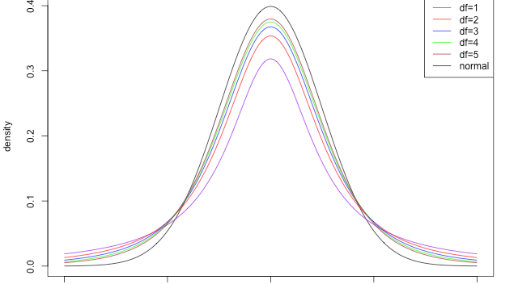
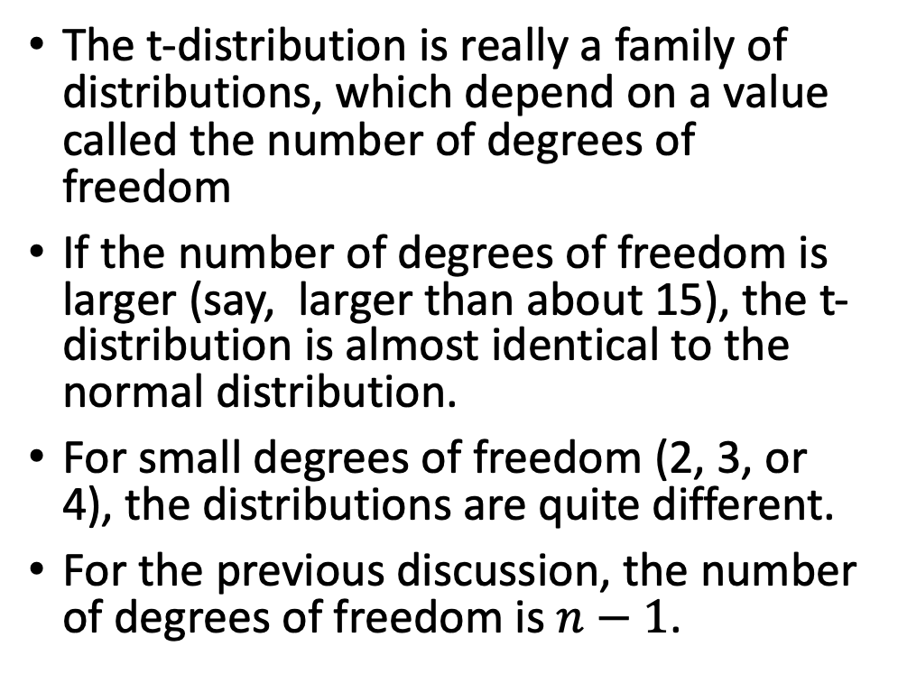
More about the t-distribution
The t-distribution is really a family of distributions, which depend on a value called the number of degrees of freedom
If the number of degrees of freedom is larger (say, larger than about 15), the t-distribution is almost identical to the normal distribution.
For small degrees of freedom (2, 3, or 4), the distributions are quite different.
For the previous discussion, the number of degrees of freedom is $n−1$.

Slide 10
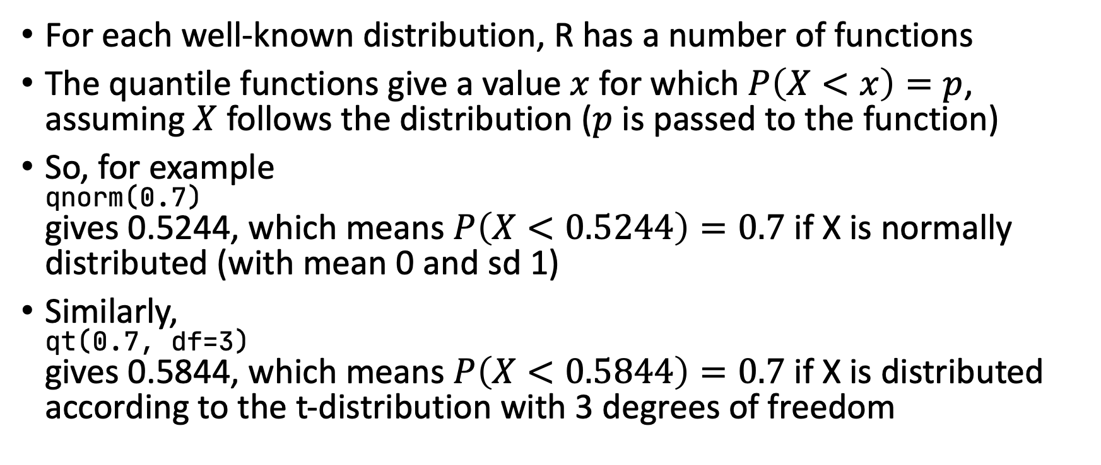

Finding $t^{∗}$ (or $z^{∗}$) in R
For each well-known distribution, R has a number of functions
The quantile functions give a value $x$ for which $P\left(X<x\right)=p$, assuming $X$ follows the distribution ($p$ is passed to the function)
So, for example
qnorm(0.7)
gives 0.5244, which means $P\left(X<0.5244\right)=0.7$ if X is normally distributed (with mean 0 and sd 1)
Similarly,
qt(0.7, df=3)
gives 0.5844, which means $P\left(X<0.5844\right)=0.7$ if X is distributed according to the t-distribution with 3 degrees of freedom

Slide 11


Care in finding $t^{∗}$ (or $z^{∗}$)
To find $z^{∗}$ for a 95% confidence interval, we want
$P\left(−z^{∗}<X<z\right)=0.95$
In pictures:
So 95%+2.5%=97.5% fall below $z^{∗}$

Slide 12

Care in finding $t^{∗}$ (or $z^{∗}$)
Generally, to find $t^{∗}$ for a confidence level $C$:
So the value to pass to qt(…) is $C+\frac{1−C}{2}=\frac{1+C}{2}$

Slide 13
Example
Find the 95% confidence interval for the Cholesterol level for TH mice fed the Chow diet
library(tidyverse)
met <- read_csv("https://denvirlab.marshall.edu/BMR617-2021/data/TH-B6-metabolic.csv")
met <- separate(met, MouseID, sep="-", into=c("Strain", "Diet", "ID"))
# Filter for TH Chow:
th_chow <- filter(met, Strain=="TH" & Diet == "Chow")
# Get the cholesterol values from the table:
chol_th_chow <- pull(th_chow, Cholesterol)
m <- mean(chol_th_chow)
s <- sd(chol_th_chow)
n <- length(chol_th_chow)
conf_level <- 0.95
t_star <- qt((1+conf_level)/2, df=n-1)
conf_int_lower <- m - t_star*s/sqrt(n)
conf_int_upper <- m + t_star*s/sqrt(n)

Slide 14
Writing functions in R
To get the confidence interval took seven lines of R code!
Each time we want the confidence interval, we could repeat these lines of code
A better way is to write our own function, so we can just call the function
The general syntax is
conf_int <- function(x) {
# ...
return(result_of_calculation)
}
We can allow optional parameters to the function by giving a default value:
conf_int <- function(x, conf_level=0.95) {
# ...
return(result_of_calculation)
}

Slide 15
A function to compute confidence intervals
conf_int <- function(x, conf_level=0.95) {
m <- mean(x)
s <- sd(x)
n <- length(x)
t_star <- qt((1+conf_level)/2, df=n-1)
conf_int_lower <- m - t_star*s/sqrt(n)
conf_int_upper <- m + t_star*s/sqrt(n)
return(c(conf_int_lower, conf_int_upper))
}

Slide 16
Using our function
We can call our function to get the 95% confidence interval using
conf_int(chol_th_chow)
To get a 99% confidence interval:
conf_int(chol_th_chow, conf_level=0.99)
Note we can get individual ends using
conf_int(chol_th_chow)[[1]]
conf_int(chol_th_chow)[[2]]

Slide 17
Bar Charts with confidence intervals as error bars
Last time we discussed error bars on bar charts:
Standard deviation is descriptive of the sample
Standard Error of the Mean is a measure of how accurately the sample mean approximates the population mean
Confidence intervals arguably give a better depiction of this
  We are 95% (for example) confident the range shown in the error bar captures the population mean
Confidence intervals are not commonly used as error bars
  But worth considering

Slide 18
Creating bar charts with confidence intervals as error bars
We can leverage our function for computing confidence intervals in our graphing code:
met_grouped <- group_by(met, Strain, Diet)
met_summary <- summarize(met_grouped,
MeanCholesterol = mean(Cholesterol),
lowerCI = conf_int(Cholesterol, conf_level=0.95)[[1]],
upperCI = conf_int(Cholesterol, conf_level=0.95)[[2]])
barplot <- ggplot(met_summary, aes(x=Diet, y=MeanCholesterol, fill=Strain)) +
geom_bar(stat='identity', position=position_dodge())
ciError <- geom_errorbar(aes(ymin=lowerCI, ymax=upperCI),
position=position_dodge(width=0.9), width=0.2)
barplot + ciError

Slide 19
Practice!
Create some bar charts:
Use SD, SEM, and Confidence Intervals for the error bars
Experiment with different confidence levels for the confidence interval error bars
Create bar charts for Cholesterol, Triglycerides, Fat Mass, Body Weight, Insulin
For each, ask whether the strain appears to affect the variable, the diet appears to affect the variable, and whether the diet effect is the same in both strains. Which group has the least variation? The most?
Modify the x- and y-axis labels, and add a title
Experiment with the colors: see http://www.sthda.com/english/wiki/ggplot2-colors-how-to-change-colors-automatically-and-manually for some examples

