Slide 1
BMR 617
The central limit theorem and the standard error of the mean
March 2nd 2021

Slide 2
Distributions
Loosely speaking a distribution of a data set describes how likely it is a point in the data set will take on a particular value
We can talk about distributions of samples, and of populations
The distribution of a sample can always be completely known, because we know the values of every data point in the data set
The distribution of a population is generally not known

Slide 3
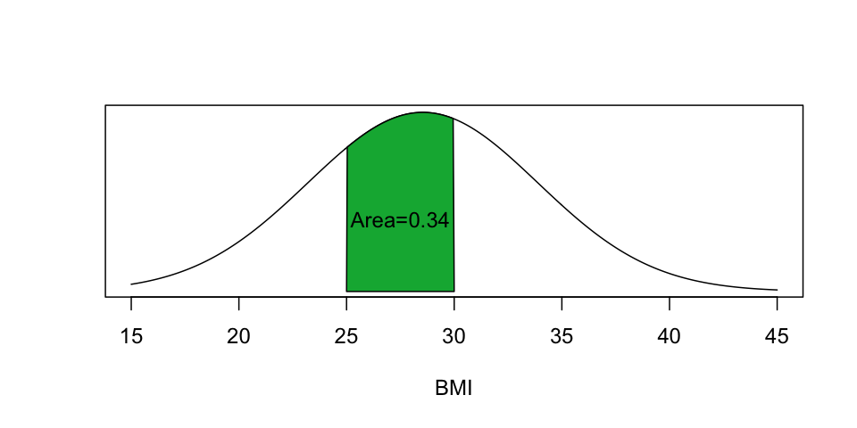
Distributions of quantitative variables
When talking about continuous quantitative variables, because the variable can take on any value on a continuum, the probability the variable is exactly equal to any given value is zero
We have to talk about the probability the variable lies within a given range

Slide 4
The normal distribution
The normal distribution is a particular distribution with certain properties
It is symmetrical about its mean
It is entirely determined by its mean and standard deviation
It has the properties that the probability a value lies within one standard deviation of the mean is approximately 0.68, and within two standard deviations of the mean is approximately 0.95.

Slide 5
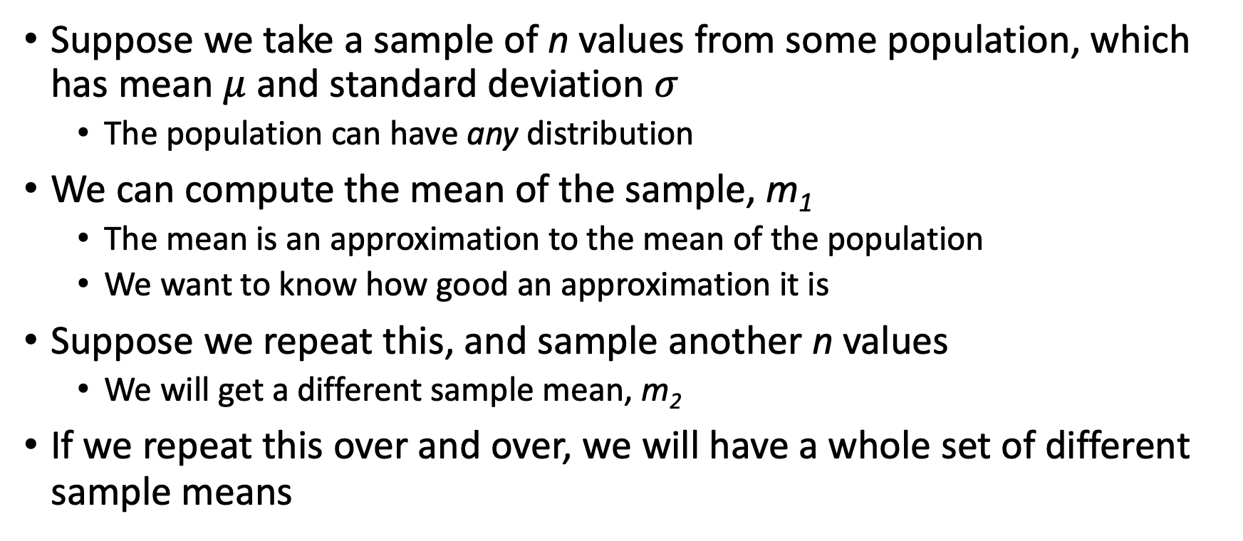
Sampling and the central limit theorem
Suppose we take a sample of n values from some population, which has mean $μ$ and standard deviation $σ$
  The population can have any distribution
We can compute the mean of the sample, m₁
  The mean is an approximation to the mean of the population
  We want to know how good an approximation it is
Suppose we repeat this, and sample another n values
  We will get a different sample mean, m₂
If we repeat this over and over, we will have a whole set of different sample means

Slide 6
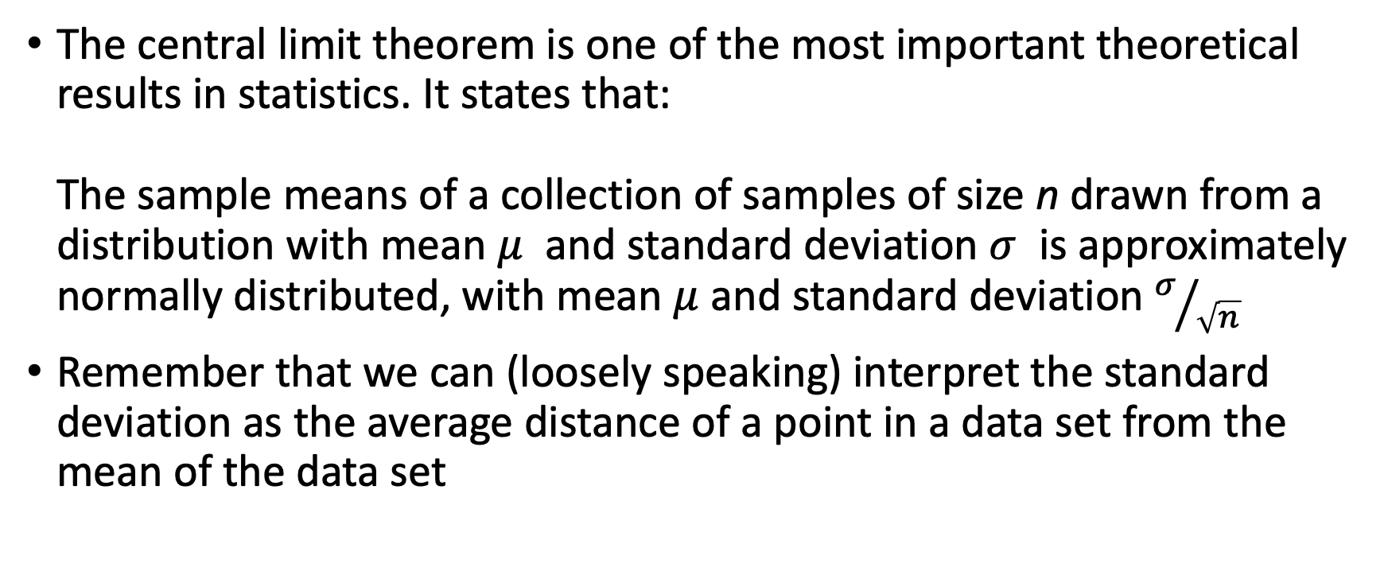
The central limit theorem
The central limit theorem is one of the most important theoretical results in statistics. It states that:
The sample means of a collection of samples of size n drawn from a distribution with mean $μ$ and standard deviation $σ$ is approximately normally distributed, with mean $μ$ and standard deviation $σ/{\sqrt{n}}$
Remember that we can (loosely speaking) interpret the standard deviation as the average distance of a point in a data set from the mean of the data set

Slide 7
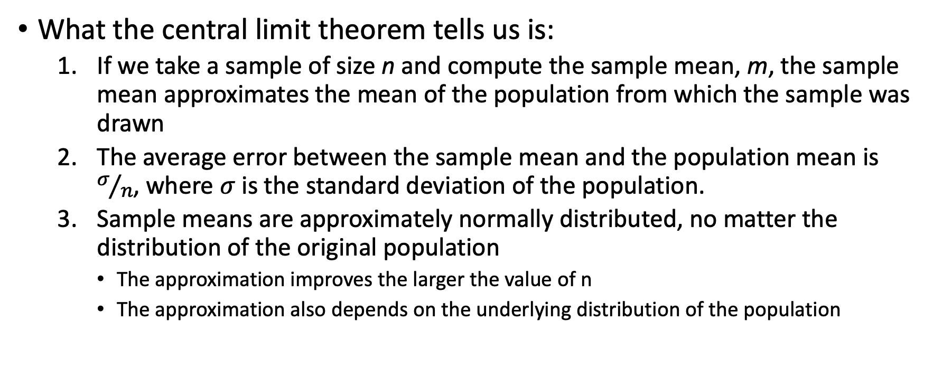
Interpreting the central limit theorem
What the central limit theorem tells us is:
  If we take a sample of size n and compute the sample mean, m, the sample mean approximates the mean of the population from which the sample was drawn
  The average error between the sample mean and the population mean is $σ/n$, where $σ$ is the standard deviation of the population.
  Sample means are approximately normally distributed, no matter the distribution of the original population
    The approximation improves the larger the value of n
    The approximation also depends on the underlying distribution of the population

Slide 8
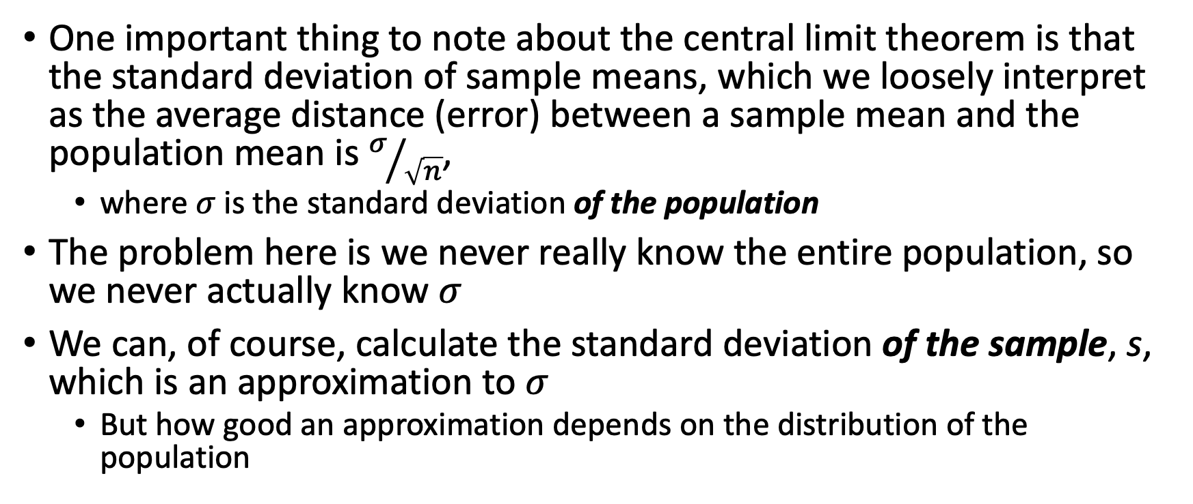
The problem with the central limit theorem
One important thing to note about the central limit theorem is that the standard deviation of sample means, which we loosely interpret as the average distance (error) between a sample mean and the population mean is $σ/{\sqrt{n}}$,
  where $σ$ is the standard deviation of the population
The problem here is we never really know the entire population, so we never actually know $σ$
We can, of course, calculate the standard deviation of the sample, s, which is an approximation to $σ$
  But how good an approximation depends on the distribution of the population

Slide 9
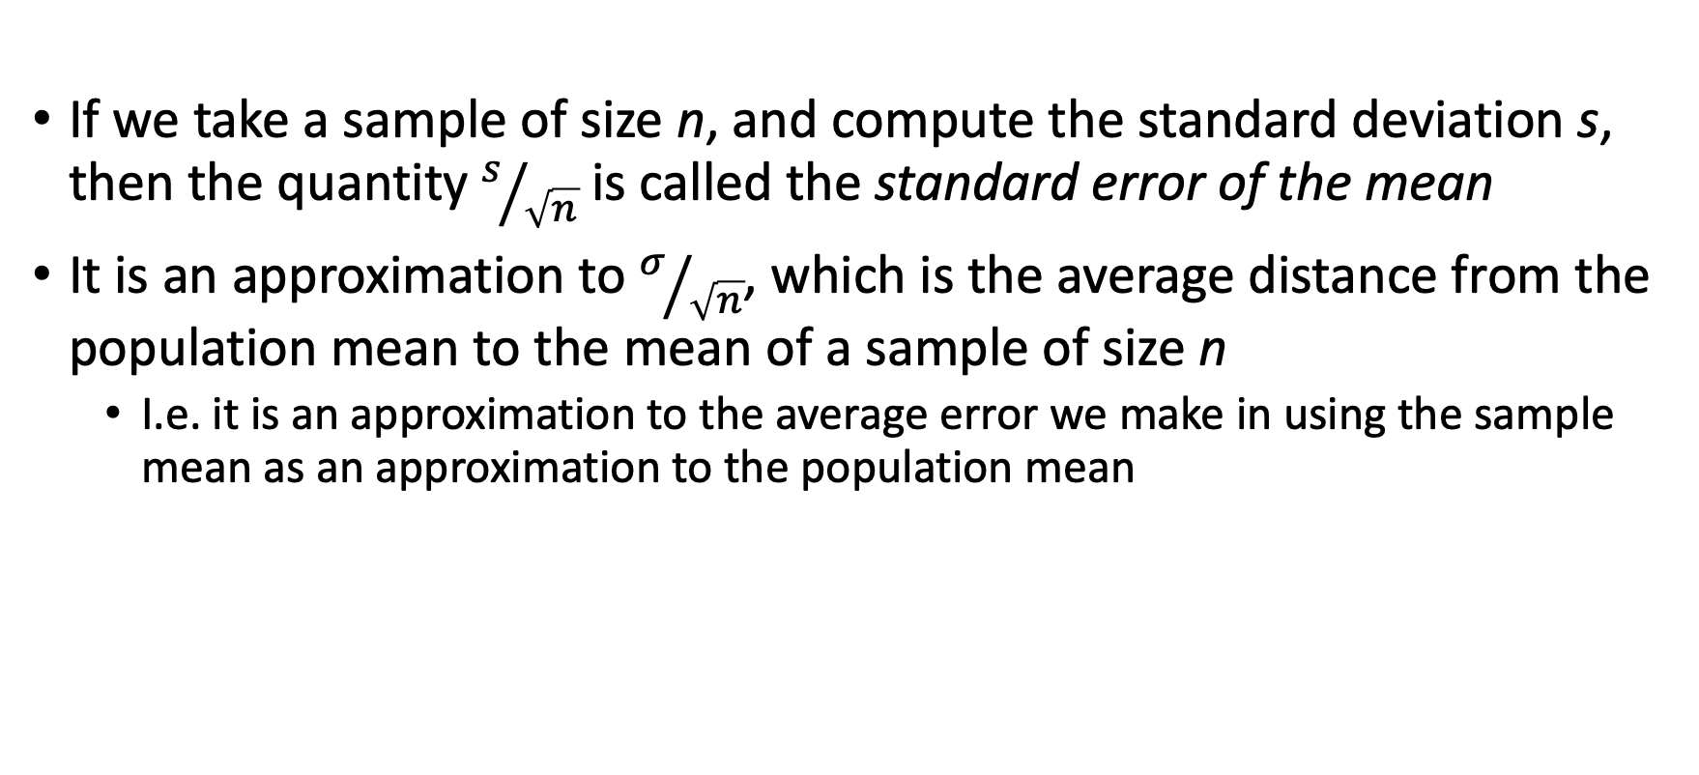
The standard error of the mean
If we take a sample of size n, and compute the standard deviation s, then the quantity $s/{\sqrt{n}}$ is called the standard error of the mean
It is an approximation to $σ/{\sqrt{n}}$, which is the average distance from the population mean to the mean of a sample of size n
  I.e. it is an approximation to the average error we make in using the sample mean as an approximation to the population mean

Slide 10
Bar Charts
We've previously plotted quantitative data using box plots and column scatter plots
  Probably the best way to show the data
  All data are shown, not just summary statistics
Some people still prefer bar charts
Use "error bars" to summarize spread in the data

Slide 11
Error bars: Standard Deviation or Standard Error of the Mean?
When showing error bars on bar charts we (currently) have two options: standard deviation, or standard error of the mean
Which to use?
Remember our interpretation:
  The standard deviation is the average distance of a point in the data set from the mean
    It's a measure of the spread in the sample
  The standard error of the mean is the average error in using the sample mean as an approximation of the population mean
    It's a measure of the precision of using this sample for inference about the population

Slide 12
Error bars: standard deviation or SEM?
Use standard deviation when the primary goal is to describe your data set
  Typically used to describe potential confounding variables in, for example, clinical trials
  Show that both control and treatment groups have similar age distributions, for example
Use standard error of the mean when the primary goal is statistical inference
  We want to show that our sample is representative of the population
  At least quantify the extent to which it represents the population
The most important thing is to clearly state what your error bars represent

Slide 13
Aside: bench experiments and populations
Consider our TH/B6 mouse diet data.
For example, let's just consider the Cholesterol data for TH mice fed the Chow diet
We have six values which comprise the sample
  But what is the population?

Slide 14
Aside: bench experiments and populations
Consider our TH/B6 mouse diet data.
For example, let's just consider the Cholesterol data for TH mice fed the Chow diet
We have six values which comprise the sample
  But what is the population?
The population here is somewhat abstract:
  It's the set of all possible values we could get from repeating this experiment
  We assume there is some "global" Cholesterol value for TH mice on Chow
  All individual measures are deviations from this "true" value based on the individual mouse and experimental condition

Slide 15
Bar Charts in R/ggplot
Start with just TH mice:
library(tidyverse)
met <- read_csv("https://denvirlab.marshall.edu/BMR617-2021/data/TH-B6-metabolic.csv")
met <- separate(met, MouseID, sep="-", into=c("Strain", "Diet", "ID"))
th <- filter(met, Strain == "TH")
We have to group and summarize the data:
th_grouped <- group_by(th, Diet)
th_summary <- summarise(th_grouped,
MeanCholesterol=mean(Cholesterol),
n=n(),
sd=sd(Cholesterol),
sem=sd/sqrt(n))
And now we can plot it:
ggplot(th_summary, aes(x=Diet, y=MeanCholesterol)) +
geom_bar(stat="identity", fill="#00B140") +
geom_errorbar(aes(ymin=MeanCholesterol-sem, ymax=MeanCholesterol+sem),width=0.2)
Can you figure out how to plot error bars with the standard deviation instead of the standard error of the mean?

Slide 16
Plotting grouped bar charts
Plot all the data, change the fill of the bars by strain:
met_grouped <- group_by(met, Diet, Strain)
met_summary <- summarise(met_grouped,
MeanCholesterol=mean(Cholesterol),
n=n(),
sd=sd(Cholesterol),
sem=sd/sqrt(n))
ggplot(met_summary, aes(x=Diet, y=MeanCholesterol, fill=Strain)) +
geom_bar(stat="identity", position=position_dodge()) +
geom_errorbar(aes(ymin=MeanCholesterol-sem
ymax=MeanCholesterol+sem),
position=position_dodge(0.9), width=0.2)

Slide 17
More plotting techniques
The layers in our plot are combined using +
We can save a layer, and then add to it
  Makes experimenting and manipulating easier
barchart <- ggplot(met_summary, aes(x=Diet, y=MeanCholesterol, fill=Strain)) +
geom_bar(stat="identity", position=position_dodge())
semErrorBars <- geom_errorbar(aes(ymin=MeanCholesterol-sem, ymax=MeanCholesterol+sem),
position=position_dodge(0.9), width=0.2)
sdErrorBars <- geom_errorbar(aes(ymin=MeanCholesterol-sd, ymax=MeanCholesterol+sd),
position=position_dodge(0.9), width=0.2)
barchart + semErrorBars
barchart + sdErrorBars

Slide 18
Adding labels and titles
Use xlab and ylab to modify the labels for the axes
Use ggtitle to add a main title
barchart + semErrorBars + ylab("Cholesterol (mg/dl)") + ggtitle("Cholesterol by Strain and Diet")

